Slide 1
A comprehensive analysis of (p)ppGpp signaling in bacteria
Molly Hydorn
Dworkin Lab, Columbia University
September 18th, 2025

Slide 2

Bacterial growth
Cell number
Time
Notes:
Typical bacterial growth curve displaying how the cell count in a culture of bacteria changes over time when cultured in growth media. Characterized by adaptive lag phase, exponential phase of rapid growth and division and thereby rapid increase in cell number, a transition phase of slowed growth, and a stationary phase of little growth and division. As cells become more dense you can imagine that the nutrients in their environment become sparser and less available, forming a sort of nutrient gradient over time

Slide 3

Bacterial growth
Lag
Cell number
Time
Notes:
Typical bacterial growth curve displaying how the cell count in a culture of bacteria changes over time in growth media. Characterized by adaptive lag phase, exponential phase of rapid growth and division and thereby rapid increase in cell number, a transition phase of slowed growth, and a stationary phase of little growth and division. As cells become more dense you can imagine that the nutrients in their environment become sparser and less available, forming a sort of nutrient gradient over time

Slide 4
Bacterial growth
Exponential
Cell number
Time
Notes:
Typical bacterial growth curve displaying how the cell count in a culture of bacteria changes over time in growth media. Characterized by adaptive lag phase, exponential phase of rapid growth and division, a transition phase of slowed growth, and a stationary phase of little growth and division. As cells become more dense you can imagine that the nutrients in their environment become sparser and less available, forming a sort of nutrient gradient over time

Slide 5
Bacterial growth
Transition
Cell number
Time
Notes:
Typical bacterial growth curve displaying how the cell count in a culture of bacteria changes over time in growth media. Characterized by adaptive lag phase, exponential phase of rapid growth and division, a transition phase of slowed growth, and a stationary phase of little growth and division. As cells become more dense you can imagine that the nutrients in their environment become sparser and less available, forming a sort of nutrient gradient over time

Slide 6
Bacterial growth
Stationary
Cell number
Time
Notes:
Typical bacterial growth curve displaying how the cell count in a culture of bacteria changes over time in growth media. Characterized by adaptive lag phase, exponential phase of rapid growth and division, a transition phase of slowed growth, and a stationary phase of little growth and division. As cells become denser the nutrients in their environment become sparser and less available, forming a sort of gradient over time

Slide 7
Bacterial growth
Nutrient availability
Amino acid availability
Cell number
Time
Notes:
Typical bacterial growth curve displaying how the cell count in a culture of bacteria changes over time when cultured in growth media. Characterized by adaptive lag phase, exponential phase of rapid growth and division and thereby rapid increase in cell number, a transition phase of slowed growth, and a stationary phase of little growth and division. As cells become more dense you can imagine that the nutrients in their environment become sparser and less available, forming a sort of nutrient gradient over time

Slide 8
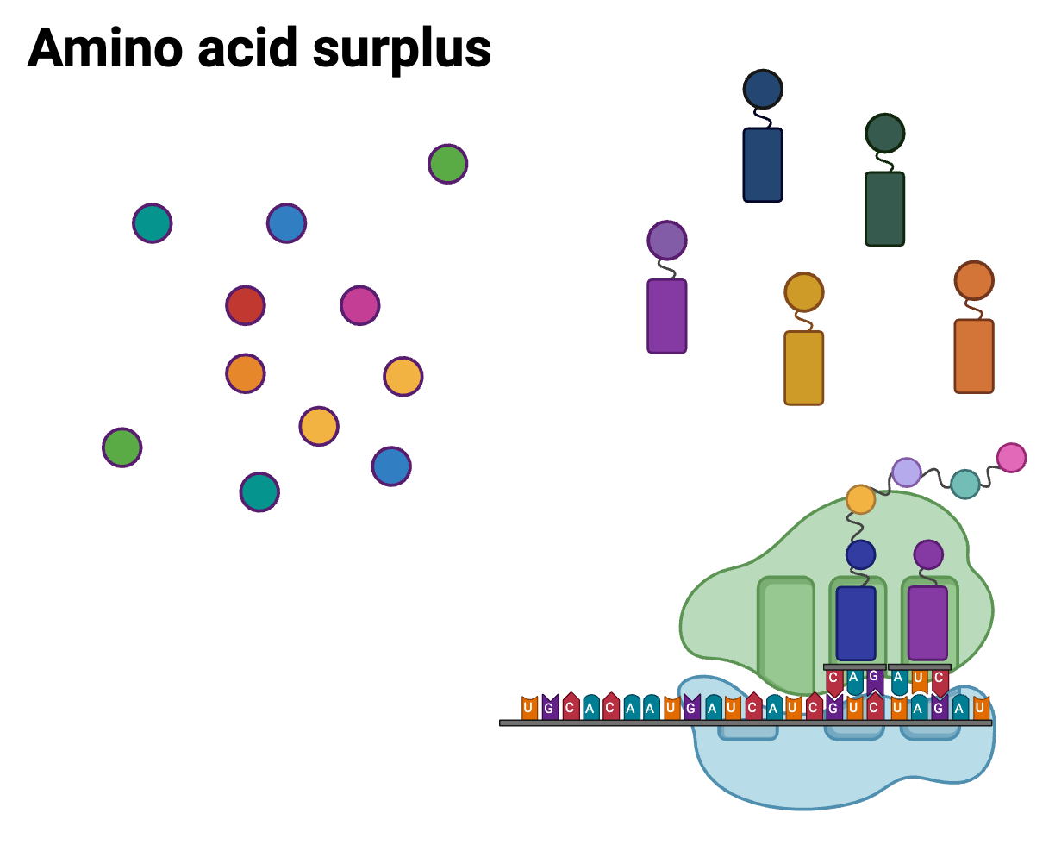
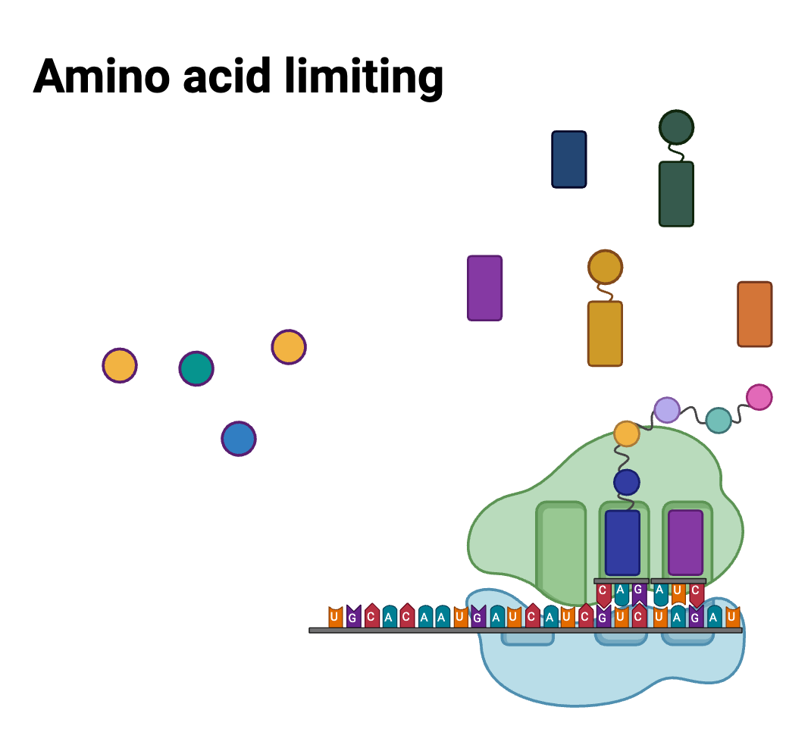
Changes in amino acid availability throughout growth
Notes:
When the cells are in the early phases of growth and have an environment rich in amino acids, the pool of tRNAs can stay relatively highly charged, meaning each tRNA has an amino acid associated with it, and ribosomes are able to carry on translation very efficiently. However, as amino acids become limiting, the pool of tRNA is not able to remain as fully charged as in surplus conditions, leaving the possibility that these uncharged tRNAs can enter an actively translating ribosome [CLICK], stalling peptide chain synthesis at the ribosomal level. This is the exact signal that bacterial cells have evolved to use as an alarm bell to start ‘hitting the brakes’ and slowing growth.

Slide 9
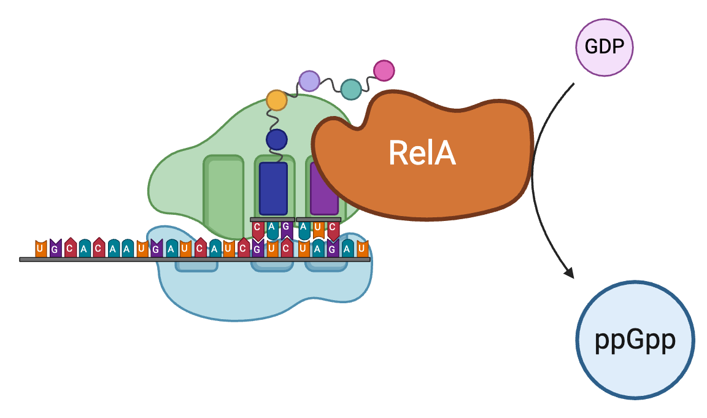
Ribosomal binding protein, RelA, produces secondary nucleotide messenger in response to amino acid starvation
Notes:
In response to an uncharged tRNA entering the ribosome during translation, ribosomal associated protein RelA begins producing alarmone secondary nucleotide messenger ppGpp. This process is conserved across all bacteria, through RelA and RelA homologues across different species

Slide 10
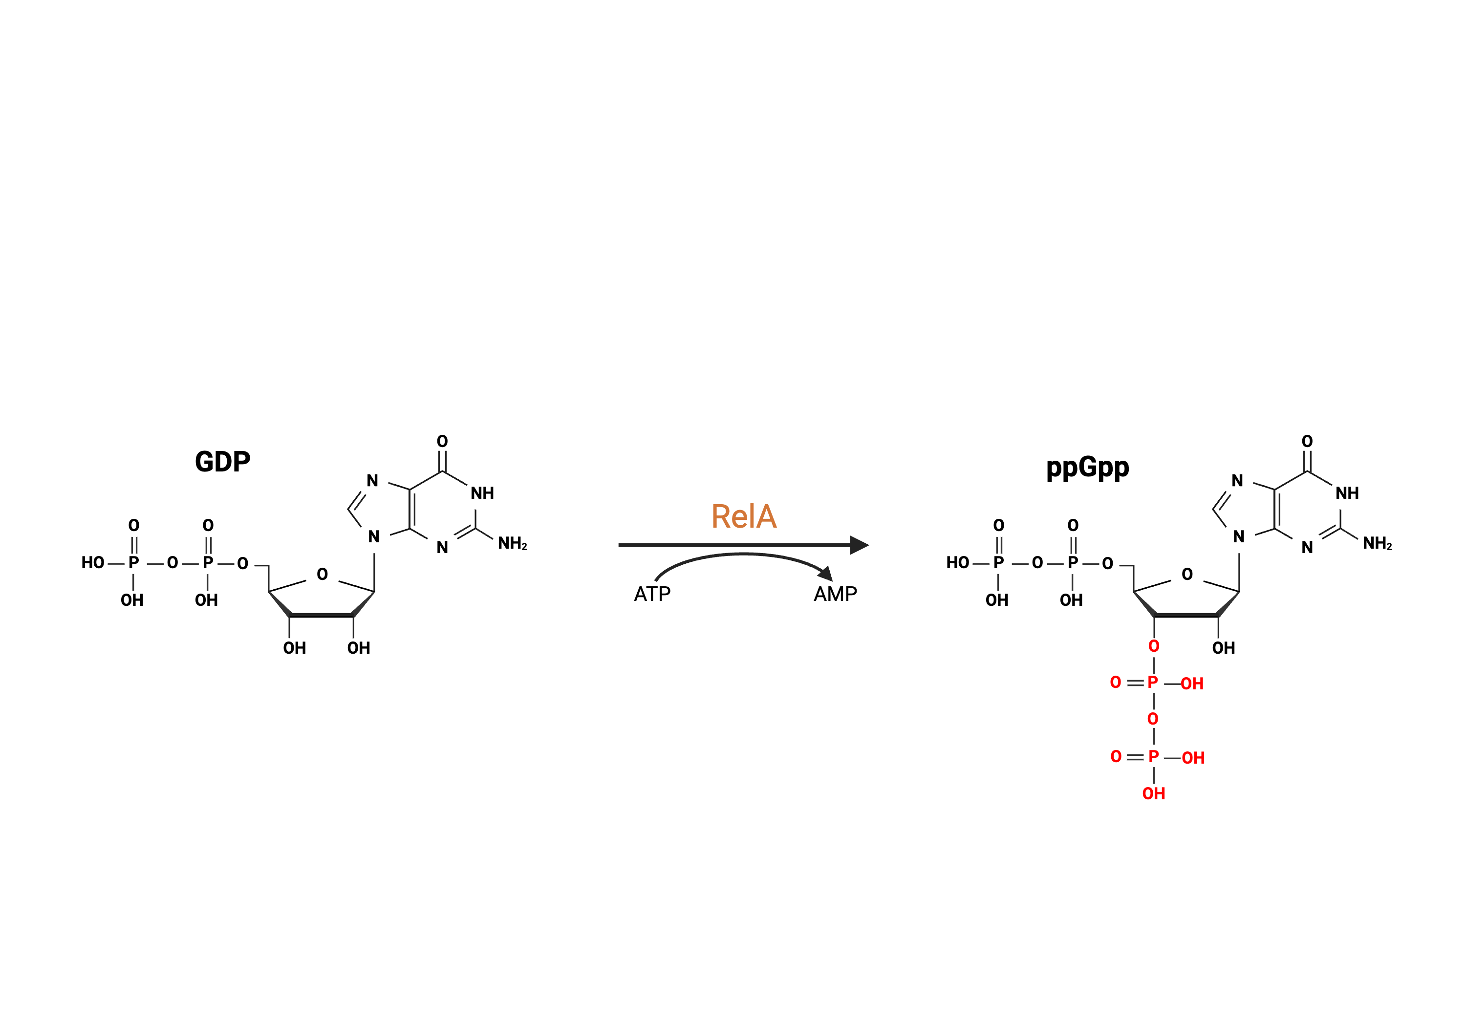
ppGpp formed by RelA from GDP and ATP nucleotides
/GTP
(p)ppGpp
/pppGpp
Notes:
ppGpp is a hyperphosphorylated guanosine nucleotide formed from GDP and ATP, hydrolyzing the gamma and beta phosphate groups from ATP onto the 3’ carbon of the GDP molecule, leaving AMP and ppGpp, the alarmone nucleotide.

Slide 11
Biological relevance of (p)ppGpp
Replication
Translation
Transcription
How can (p)ppGpp be measured in bacteria?
Notes:
ppGpp has a number of biological targets, working to downregulate metabolism and growth of cells by slowing key processes. ppGpp has been shown to attenuate DNA replication, slowing a necessary step for division. Work from our own lab by former student Simon with the Gonzalez lab down in chemistry at the morningside campus has demonstrated how ppGpp blocks translation by inhibiting ribosomal initiation complex formation. Additionally, work in the field has shown how ppGpp acts to block transcription, in some organisms like E coli by binding RNAP directly to slow global transcription, but work in our own lab by a postdoc you’ve heard from here at RIP last time, Sathya, has demonstrated how ppGpp works to also upregulate the transcription of certain genes, particularly stationary phase genes. Because ppGpp is such a key player for downregulating the processes and preparing the cells for less favorable conditions, there is a lot of interest in understanding the metabolism of ppGpp itself and the different cellular physiologies of cells with higher or lower ppGpp levels, which is precisely what I hope to address in my project.

Slide 12
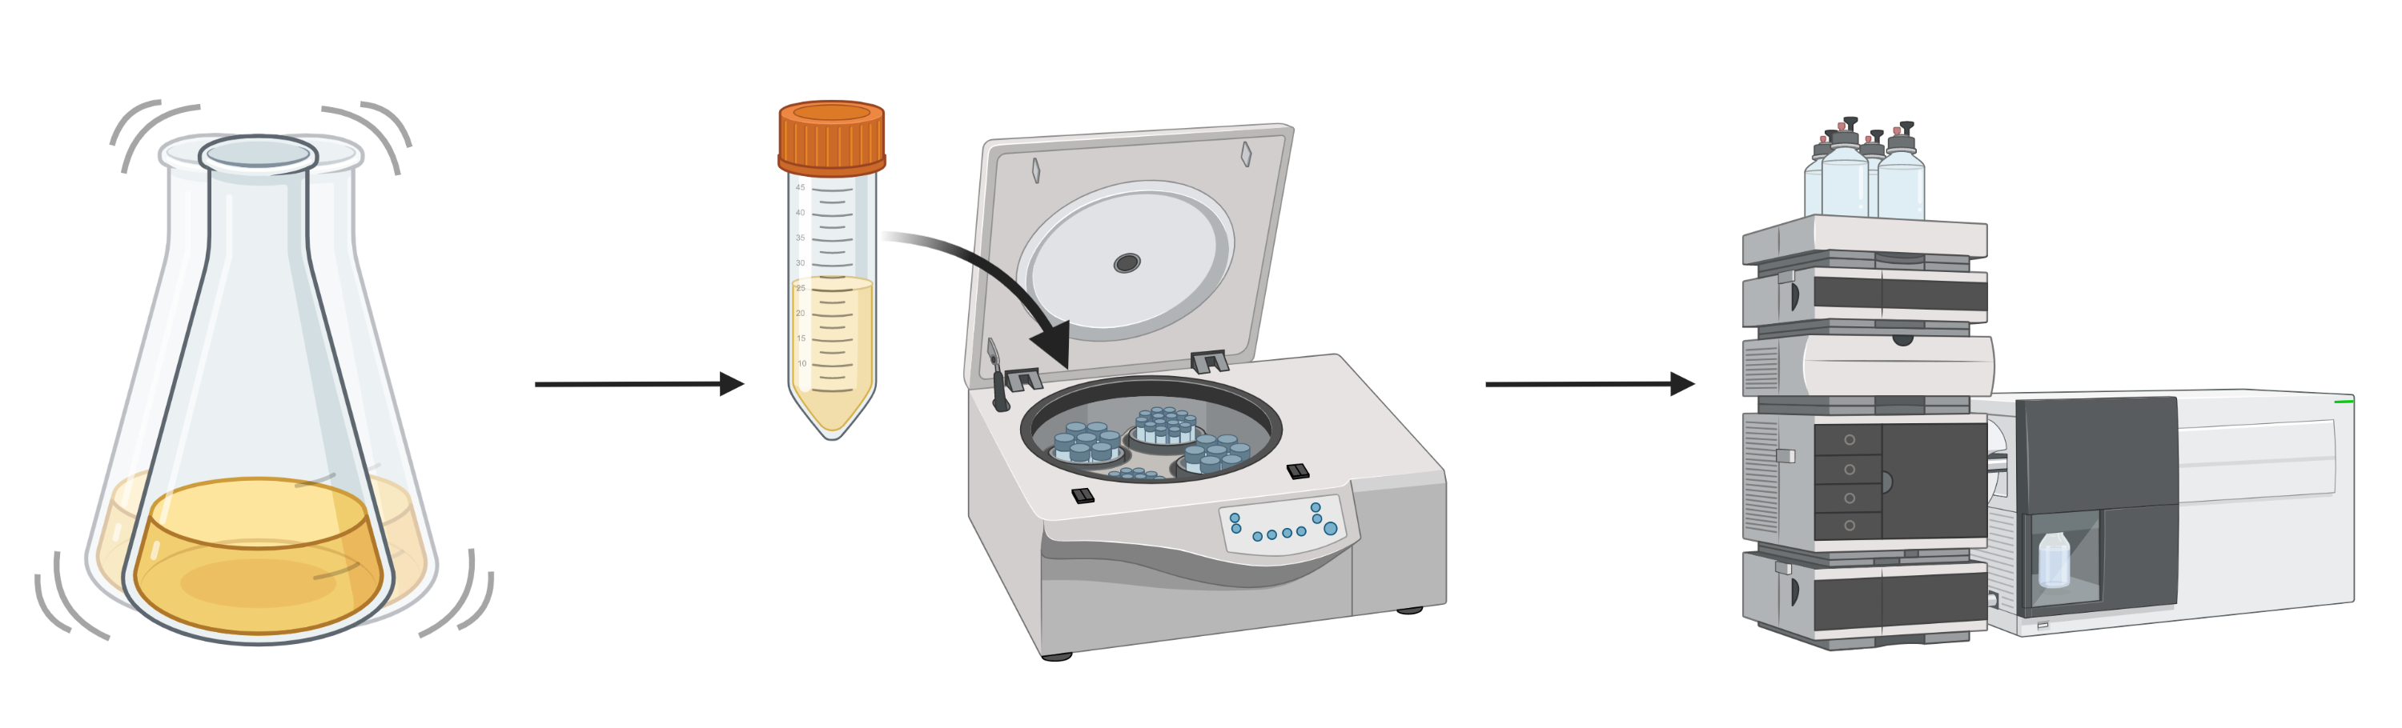
Current methods of in vivo (p)ppGpp analysis: LC-MS
Insensitive
Hard to achieve high temporal resolution
Bulk measurement
Notes:
Firstly, I’d like to discuss the main methods of measuring ppGpp in bacterial culture. The ‘old school’ method involves pulsing a culture with radioactive phosphorous, P32, isolating nucleotides from lysate via TLC, and using autoradiography to assess ppGpp. The more common emerging method has been to use LC-MS, that is chromotography in conjunction with mass spec. This involves harvesting nucleotides from large volumes of bacterial culture, quantifying and isolating those nucleotides via HPLC, and confirming identity on mass spec. While this method is powerful in giving an absolute concentration of nucleotides from culture, it’s quite insensitive, requiring a larger volume of cells to be able to get to detectable levels, and only gives a single value for culture, leaving no room to interpret single cell variation. It’s also difficult to achieve high temporal resolution, leaving gaps in knowledge along the growth curve. This was the premier method of measuring ppGpp in culture up until the discovery of these ppGpp riboswitches.

Slide 13
Aims of this thesis
Aim 1: Develop and validate a (p)ppGpp detection tool
Aim 2: Characterize bacterial (p)ppGpp metabolism and (p)ppGpp-dependent physiology
Aim 3: Analyze (p)ppGpp signaling heterogeneity within a population

Slide 14
Aim 1: Develop and validate a (p)ppGpp detection tool
(p)ppGpp specific: signal seen in response to (p)ppGpp alone
Dynamic: signal fluctuates to reflect (p)ppGpp dynamics over time
Accurate: signal reflects actual (p)ppGpp levels
Sensitive: signal respond to acute amino acid starvation

Slide 15
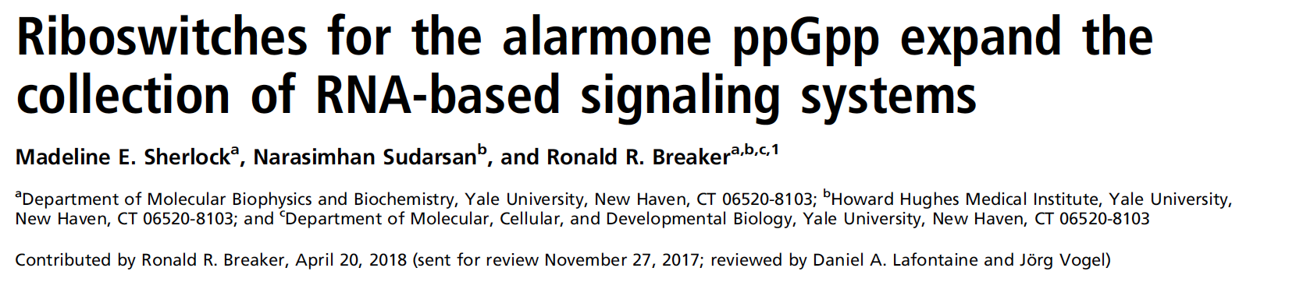
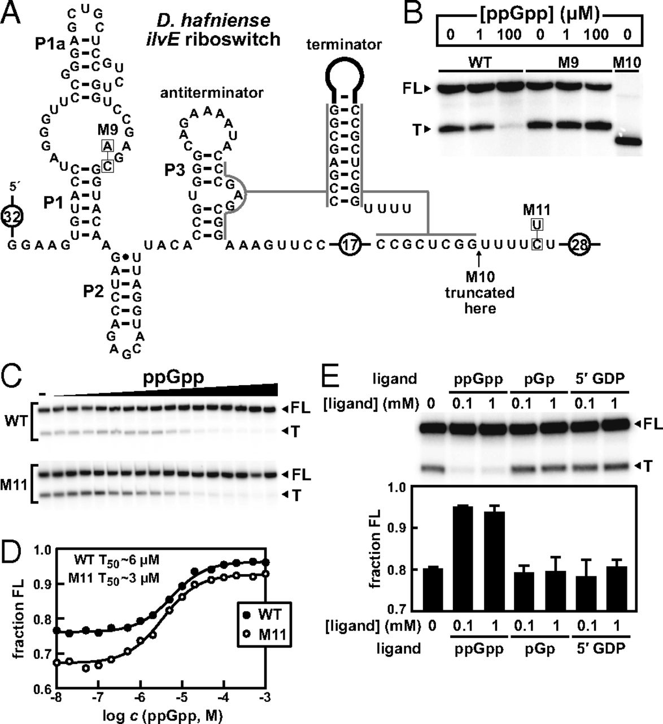
Notes:
This riboswitch comes from Desulfitobacter hafniense. Madeleine demonstrated using an in vitro transcription assay that at low or no ppGpp, the riboswitch formed a terminator configuration, blocking downstream transcription, resulting in truncated transcript formation. When there are high levels of ppGpp, the riboswitch bound the ligand and assumed the antiterminator configuration, allowing for downstream transcription and full length transcript. This provided a good basis for a transcriptional reporter.

Slide 16
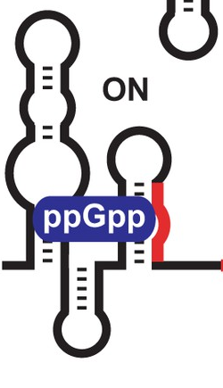
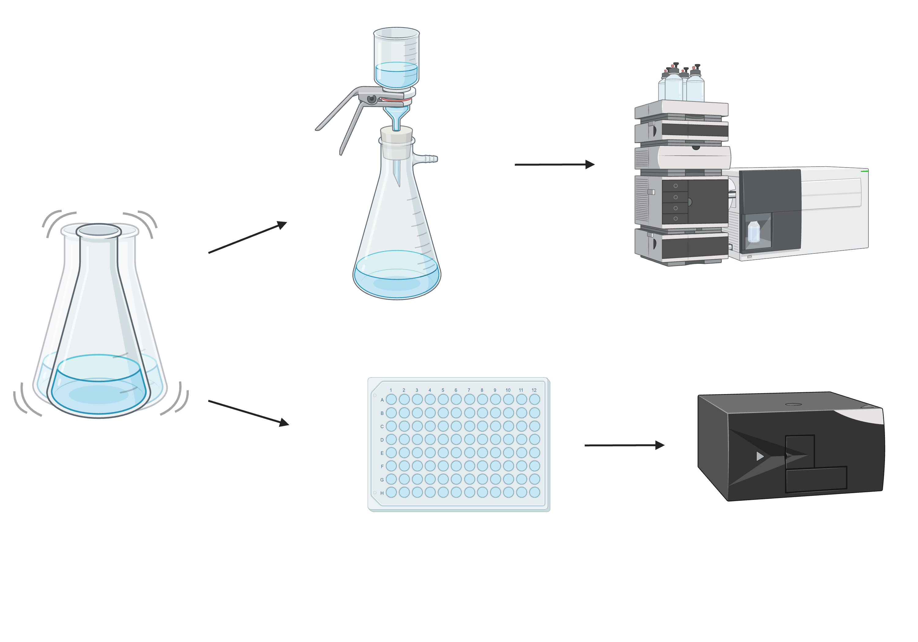
Dynamic (p)ppGpp luciferase reporter in model bacterium, Bacillus subtilis
ilvE riboswitch
Physpank
RsFluc
firefly luciferase
No background luminescence
~ 5-minute half-life
David Dubnau
Notes:
There are a couple of advantages to using this luminescent reporter. One being unlike a fluorescent reporter, there is no background luminescence, allowing for high signal to noise. Another being that the luciferase protein has 5 minute half life in bacillus, getting degrading quite quickly after being synthesize. This allows for a very dynamic luminescent readout, reporting on changes in ppGpp in a very short time scale. Using this construct integrated at a nonessential locus in the genome, we can monitor changes in ppGpp levels throughout growth as changes in luminescence.

Slide 17
Dynamic (p)ppGpp luciferase reporter in model bacterium, Bacillus subtilis
OD
RsFluc
Hydorn et al. 2025
Notes:
With the growth curve displayed here in black and the luminescence signal displayed in blue, you can see that as cells are beginning to exit exponential growth in chemical defined medium, there is a wave of luminescence, indicating a wave of ppGpp. I was very excited to see this result, although it is hard to appreciate while looking at a growth curve, but looking at growth rate

Slide 18
(p)ppGpp synthetases in B. subtilis
RelA
Hydrolase
synthetase
CTD
SasA
synthetase
SasB
synthetase
(p)ppGpp⁰ strain
Notes:
In bacillus subtilis there are actually three ppGpp synthetases. I’ve already told you a little about RelA, which is regulated through ribosomal binding at the CTD to switch from a hydrolase to a synthetase when the cell encounters amino acid limitation. Bacillus also has two small alarmone synthetases, known as sasA and sasB. We’ve created a strain in which the synthetase activity of these proteins has been mutated, disallowing for ppGpp production, which we refer to as the ppGpp null strain.

Slide 19
Dynamic (p)ppGpp luciferase reporter, RsFluc
OD
RsFluc
RsFluc (p)ppGpp⁰
Hydorn et al. 2025
Notes:
Looking at the reporter signal in the ppGpp null strain we saw luminescence significantly attenuated, suggesting that our reporter was in fact responding to changes in ppGpp levels. Though there is a slight response from the null strain that we hypothesize is due to physiological differences that occur as a result of the lack of ppGpp, like increased protein synthesis in transition phase. As a second control we also employed a ppGpp insensitive riboswitch construct.

Slide 20
Sherlock, M, et al. PNAS, 2018.
Notes:
In the ppGpp riboswitch paper, Madeleine identified some key mutations that affect riboswitch response in the presence and absence of ppGpp. The first of which was the M9 mutation. This mutation they explained, disrupted the binding pocket, effectively blocking ppGpp from binding, and leaving the riboswitch acting as a terminator, shown in their in vitro transcription assay. They also identified the M11 mutation and characterized this as a way to strengthen the terminator structure.

Slide 21
Dynamic (p)ppGpp luciferase reporter with mutant riboswitch, RsFluc^{mut}
ilvE riboswitch
Physpank
RsFluc
firefly luciferase
ilvE mut riboswitch
Physpank
RsFluc^{mut}
firefly luciferase
Notes:
Engineering this ppGpp insensitive riboswitch, we similarly fused it upstream of luciferase and downstream of our inducible promoter and monitored luminescence of this construct throughout growth.

Slide 22
RsFluc ligand specificity
OD
RsFluc
RsFluc (p)ppGpp⁰
RsFluc^{mut}
Hydorn et al. 2025
Notes:
What we saw again was severely attenuated signal. Again this suggested to us that our WT riboswitch reporter was accurately reporter on changes in ppGpp.

Slide 23
Aim 1: Develop and validate a (p)ppGpp detection tool
(p)ppGpp specific: signal seen in response to (p)ppGpp alone
Dynamic: signal fluctuates to reflect (p)ppGpp dynamics over time
Accurate: signal reflects actual (p)ppGpp levels
Sensitive: signal respond to acute amino acid starvation

Slide 24
Biological relevance of (p)ppGpp
Replication
Translation
Transcription
Notes:
ppGpp has a number of biological targets, working to downregulate metabolism and growth of cells by slowing key processes. ppGpp has been shown to attenuate DNA replication, slowing a necessary step for division. Work from our own lab by former student Simon with the Gonzalez lab down in chemistry at the morningside campus has demonstrated how ppGpp blocks translation by inhibiting ribosomal initiation complex formation. Additionally, work in the field has shown how ppGpp acts to block transcription, in some organisms like E coli by binding RNAP directly to slow global transcription, but work in our own lab by a postdoc you’ve heard from here at RIP last time, Sathya, has demonstrated how ppGpp works to also upregulate the transcription of certain genes, particularly stationary phase genes. Because ppGpp is such a key player for downregulating the processes and preparing the cells for less favorable conditions, there is a lot of interest in understanding the metabolism of ppGpp itself and the different cellular physiologies of cells with higher or lower ppGpp levels, which is precisely what I hope to address in my project.

Slide 25
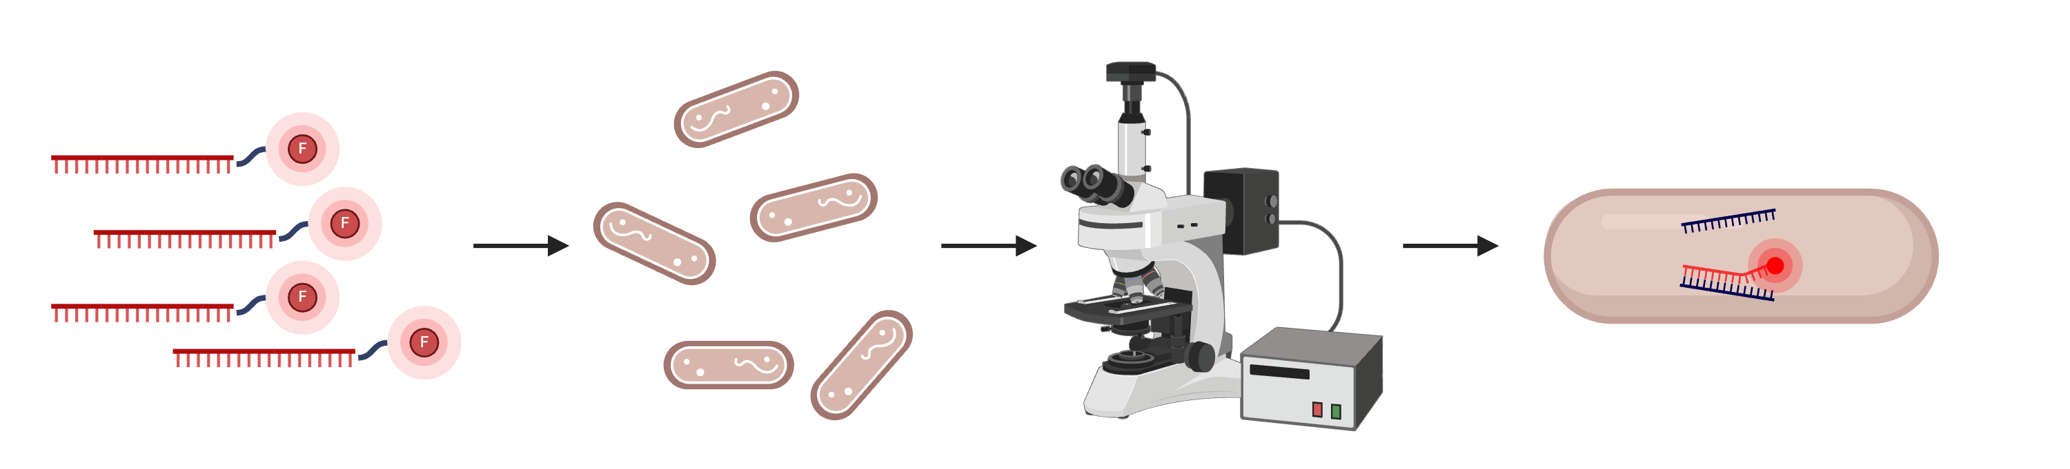
Fluorescent in situ hybridization (FISH) microscopy in dual reporter
yfp mRNA probes
ilvE riboswitch
ilvE riboswitch
Physpank
Physpank
firefly luciferase
yfp
Abigail Whalen

Slide 26
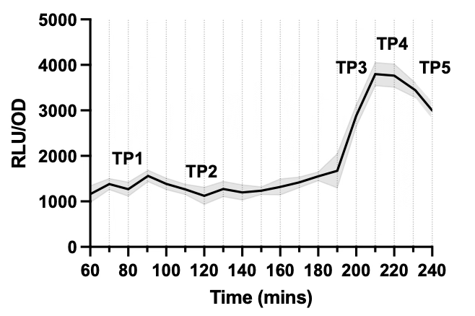
Transcription of reporter and luminescent signal
ilvE riboswitch
ilvE riboswitch
Physpank
Physpank
firefly luciferase
yfp
Hydorn et al. 2025

Slide 27
Aim 1: Develop and validate a (p)ppGpp detection tool
(p)ppGpp specific: signal seen in response to (p)ppGpp alone
Dynamic: signal fluctuates to reflect (p)ppGpp dynamics over time
Accurate: signal reflects actual (p)ppGpp levels
Sensitive: signal respond to acute amino acid starvation

Slide 28
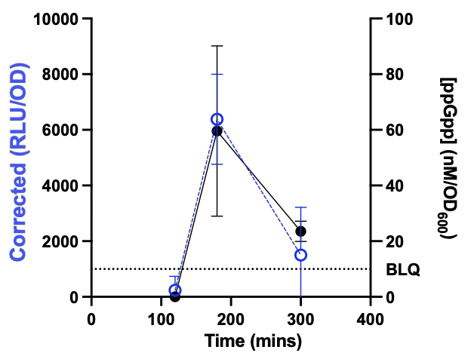
Biochemical validation of RsFluc dynamics
Elizabeth Fones, UW
Hydorn et al. 2025
Notes:
Displayed here on the left are the luminescence values that were determined on the luminometer by me from the samples collected for LC-MS, subtracting the luminescence of the null strain. As you can see, I collected during times of relatively low luminescence, high, and then low again, expecting low high low levels of ppGpp production. Here on the right are the concentrations of ppGpp as determined by the LC-MS analysis. Even though we were already confident that our reporter was responding to changes in ppGpp, this experiment really assured us that it was sensitive, highly temporally resolved, and actually responding to our target metabolite

Slide 29
Aim 1: Develop and validate a (p)ppGpp detection tool
(p)ppGpp specific: signal seen in response to (p)ppGpp alone
Dynamic: signal fluctuates to reflect (p)ppGpp dynamics over time
Accurate: signal reflects actual (p)ppGpp levels
Sensitive: signal respond to acute amino acid starvation

Slide 30
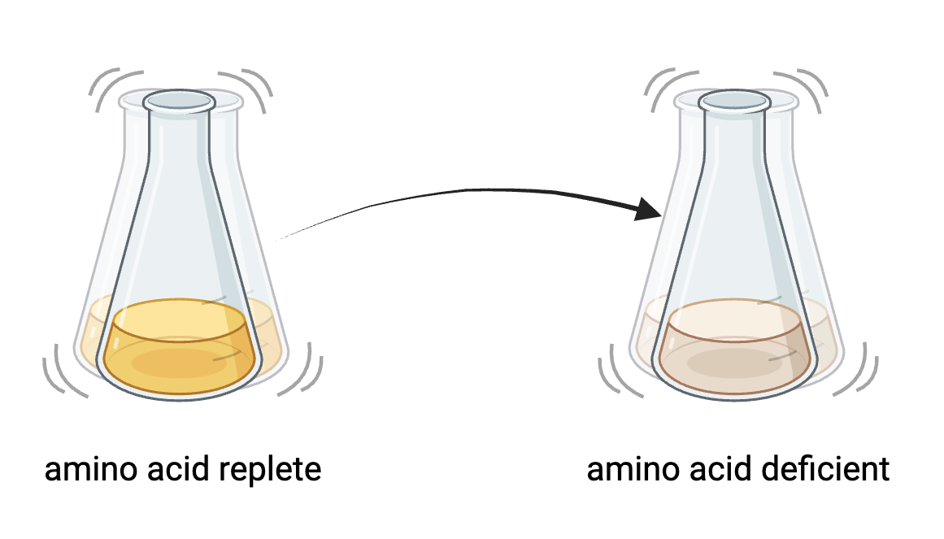
Nutrient downshift experiment
Notes:
TO continue validating this reporter, we turned to a common experiment in the field to induce ppGpp produce known as a nutrient downshift. In these experiments, researchers grow the bacteria in an amino acid replete (or surplus) medium, then transfer the bacteria to an amino acid deficient medium. This triggers an amino acid starvation response through RelA and results in high levels of ppGpp. I performed this experiment using our luminescent reporter to ensure that it was able to respond to quick changes in ppGpp production.

Slide 31
Nutrient downshifts result in increased luminescence in reporter
Hydorn et al. 2025
Notes:
What I saw when I began measuring luminescence immediately after shifting to the amino acid deficient conditions was an acute spike in luminescence, indicating a sharp wave of ppGpp as a result of amino acid starvation. To ensure this was not a result of instrumental error being that luminescence was being measured right as the program was beginning, I also performed the nutrient downshift at 60 minutes into growth, and the culture produced a sharp wave of luminescence right after being nutrient downshifted. This validated that our reporter is sensitive to acute changes in ppGpp levels as result of a changing environment.

Slide 32
Aim 1: Develop and validate a (p)ppGpp detection tool
(p)ppGpp specific: signal seen in response to (p)ppGpp alone
Dynamic: signal fluctuates to reflect (p)ppGpp dynamics over time
Accurate: signal reflects actual (p)ppGpp levels
Sensitive: signal respond to acute amino acid starvation

Slide 33
Aims of this thesis
Aim 1: Develop and validate a (p)ppGpp detection tool
Aim 2: Characterize bacterial (p)ppGpp metabolism and (p)ppGpp-dependent physiology
Aim 3: Analyze (p)ppGpp signaling heterogeneity within a population

Slide 34
Aim 2: Characterize bacterial (p)ppGpp metabolism and (p)ppGpp-dependent physiology
Evaluate (p)ppGpp synthetases relative contributions to metabolism
Evaluate (p)ppGpp hydrolase contribution to metabolism
Determine environmental factors effect on metabolism
Assess transcriptional response to (p)ppGpp
Examine (p)ppGpp-dependent physiology

Slide 35
Evaluate relative contributions of (p)ppGpp synthetases in B. subtilis
RelA
Hydrolase
Synthetase
CTD
SasA
Synthetase
SasB
Synthetase
Notes:
In bacillus subtilis there are actually three ppGpp synthetases. I’ve already told you a little about RelA, which is regulated through ribosomal binding at the CTD to switch from a hydrolase to a synthetase when the cell encounters amino acid limitation. Bacillus also has two small alarmone synthetases, known as sasA and sasB. We’ve created a strain in which the synthetase activity of these proteins has been mutated, disallowing for ppGpp production, which we refer to as the ppGpp null strain.

Slide 36
Evaluate relative contributions of (p)ppGpp synthetases in B. subtilis
RelA
Hydrolase
Synthetase
CTD
SasA
Synthetase
SasB
Synthetase
Notes:
In bacillus subtilis there are actually three ppGpp synthetases. I’ve already told you a little about RelA, which is regulated through ribosomal binding at the CTD to switch from a hydrolase to a synthetase when the cell encounters amino acid limitation. Bacillus also has two small alarmone synthetases, known as sasA and sasB. We’ve created a strain in which the synthetase activity of these proteins has been mutated, disallowing for ppGpp production, which we refer to as the ppGpp null strain.

Slide 37
Evaluate relative contributions of (p)ppGpp synthetases in B. subtilis
RelA
Hydrolase
Synthetase
CTD
SasA
Synthetase
SasB
Synthetase
Notes:
In bacillus subtilis there are actually three ppGpp synthetases. I’ve already told you a little about RelA, which is regulated through ribosomal binding at the CTD to switch from a hydrolase to a synthetase when the cell encounters amino acid limitation. Bacillus also has two small alarmone synthetases, known as sasA and sasB. We’ve created a strain in which the synthetase activity of these proteins has been mutated, disallowing for ppGpp production, which we refer to as the ppGpp null strain.

Slide 38
Evaluate relative contributions of (p)ppGpp synthetases in B. subtilis
RelA
Hydrolase
Synthetase
CTD
SasA
Synthetase
SasB
Synthetase
Notes:
In bacillus subtilis there are actually three ppGpp synthetases. I’ve already told you a little about RelA, which is regulated through ribosomal binding at the CTD to switch from a hydrolase to a synthetase when the cell encounters amino acid limitation. Bacillus also has two small alarmone synthetases, known as sasA and sasB. We’ve created a strain in which the synthetase activity of these proteins has been mutated, disallowing for ppGpp production, which we refer to as the ppGpp null strain.

Slide 39
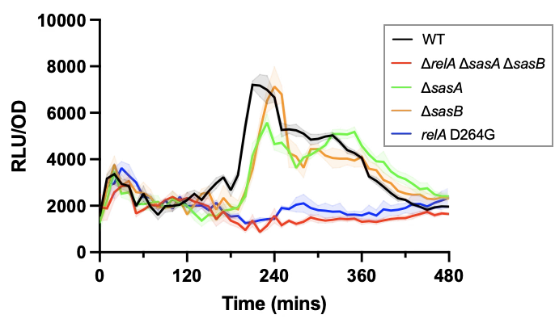
Relative contributions of (p)ppGpp synthetases in B. subtilis
Hydorn et al. 2025

Slide 40
Aim 2: Characterize bacterial (p)ppGpp metabolism and (p)ppGpp-dependent physiology
Evaluate (p)ppGpp synthetases relative contributions to metabolism
Evaluate (p)ppGpp hydrolase contribution to metabolism
Determine environmental factors effect on metabolism
Assess transcriptional response to (p)ppGpp
Examine (p)ppGpp-dependent physiology

Slide 41
RelA dual catalytic activity in B. subtilis
RelA
Hydrolase
Synthetase
CTD
Notes:
In bacillus subtilis there are actually three ppGpp synthetases. I’ve already told you a little about RelA, which is regulated through ribosomal binding at the CTD to switch from a hydrolase to a synthetase when the cell encounters amino acid limitation. Bacillus also has two small alarmone synthetases, known as sasA and sasB. We’ve created a strain in which the synthetase activity of these proteins has been mutated, disallowing for ppGpp production, which we refer to as the ppGpp null strain.

Slide 42
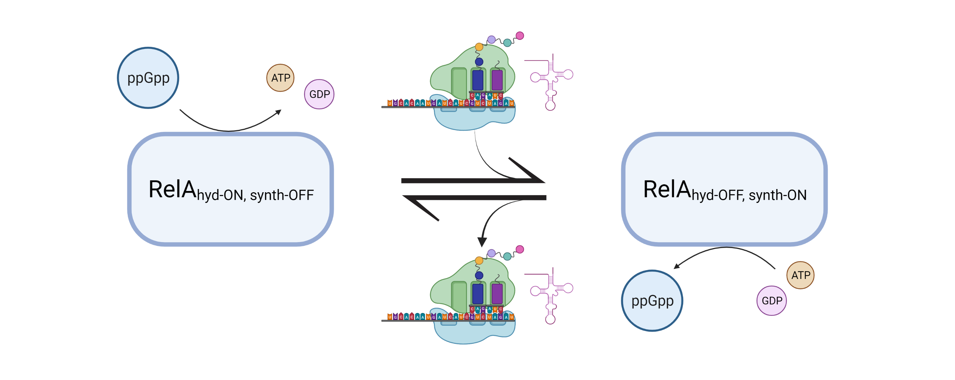
RelA catalytic cycle

Slide 43
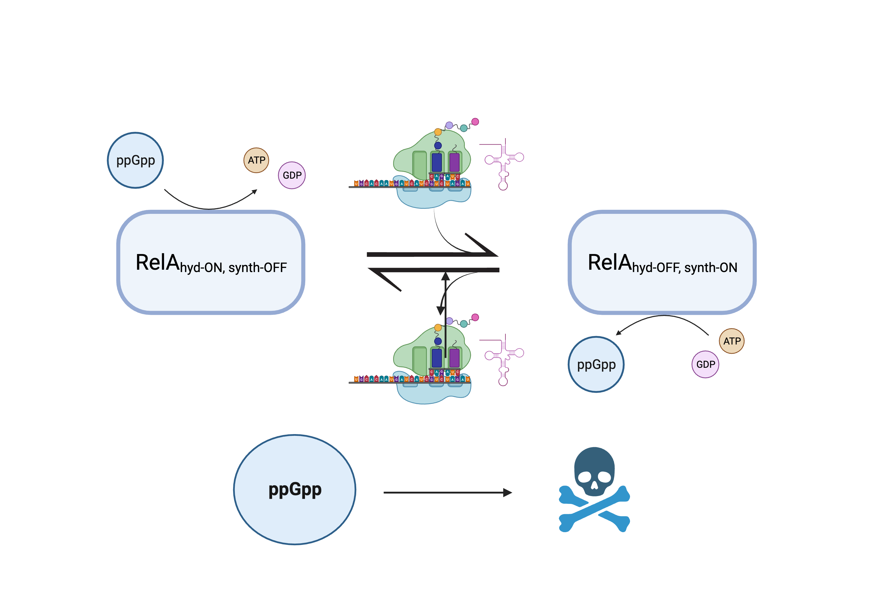
Hydrolase activity essential in B. subtilis

Slide 44
(p)ppGpp synthetases and hydrolase in B. subtilis
RelA
Hydrolase
synthetase
CTD
SasA
synthetase
SasB
synthetase
(p)ppGpp⁰ strain
Notes:
In bacillus subtilis there are actually three ppGpp synthetases. I’ve already told you a little about RelA, which is regulated through ribosomal binding at the CTD to switch from a hydrolase to a synthetase when the cell encounters amino acid limitation. Bacillus also has two small alarmone synthetases, known as sasA and sasB. We’ve created a strain in which the synthetase activity of these proteins has been mutated, disallowing for ppGpp production, which we refer to as the ppGpp null strain.

Slide 45
Inducible relA system at ectopic locus
(p)ppGpp⁰ strain background
PliaI
WT
relA
PliaI
HD^{mut}
relA D78A

Slide 46
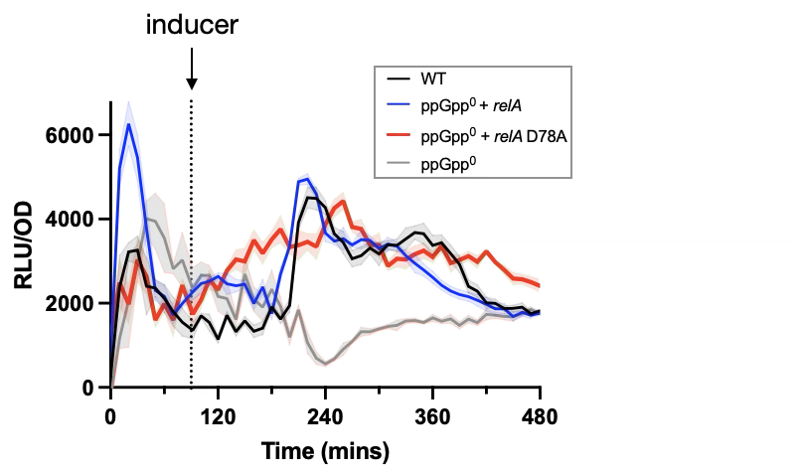
Evaluating the contributions of hydrolases to (p)ppGpp metabolism
PliaI
relA
PliaI
relA D78A
Hydorn et al. 2025

Slide 47
Aim 2: Characterize bacterial (p)ppGpp metabolism and (p)ppGpp-dependent physiology
Evaluate (p)ppGpp synthetases relative contributions to metabolism
Evaluate (p)ppGpp hydrolase contribution to metabolism
Determine environmental factors effect on metabolism
Assess transcriptional response to (p)ppGpp
Examine (p)ppGpp-dependent physiology

Slide 48
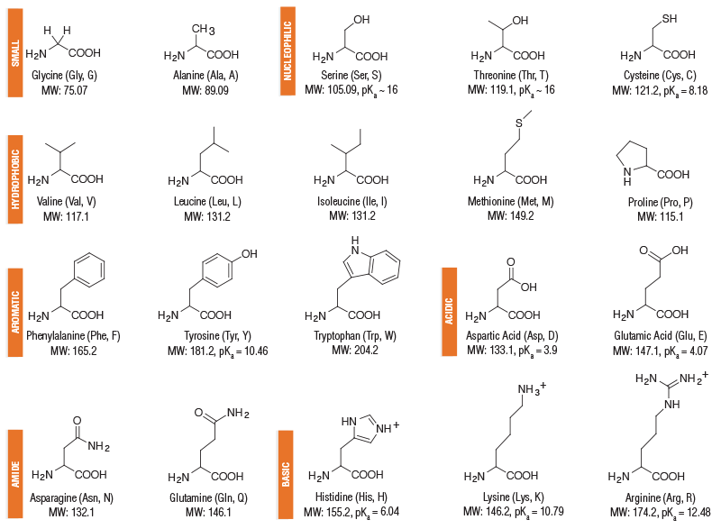
Amino acid prototrophy
Carbon source:
+
Nitrogen source:
NEB

Slide 49
RelA produces (p)ppGpp in response to amino acid starvation
Notes:
In response to an uncharged tRNA entering the ribosome during translation, ribosomal associated protein RelA begins producing alarmone secondary nucleotide messenger ppGpp. This process is conserved across all bacteria, through RelA and RelA homologues across different species

Slide 50
Environmental factors contribute to RsFluc
0.005% CAA
0.01% CAA
0.02% CAA
Hydorn et al. 2025

Slide 51
RsFluc response in amino acid prototrophic conditions

Slide 52
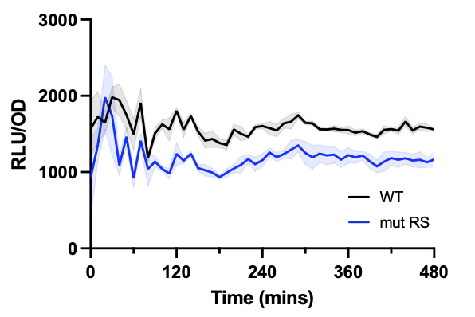
RsFluc response in amino acid prototrophic conditions
RsFluc
RsFluc^{mut}
Hydorn et al. 2025

Slide 53
Aim 2: Characterize bacterial (p)ppGpp metabolism and (p)ppGpp-dependent physiology
Evaluate (p)ppGpp synthetases relative contributions to metabolism
Evaluate (p)ppGpp hydrolase contribution to metabolism
Determine environmental factors effect on metabolism
Assess transcriptional response to (p)ppGpp
Examine (p)ppGpp-dependent physiology

Slide 54
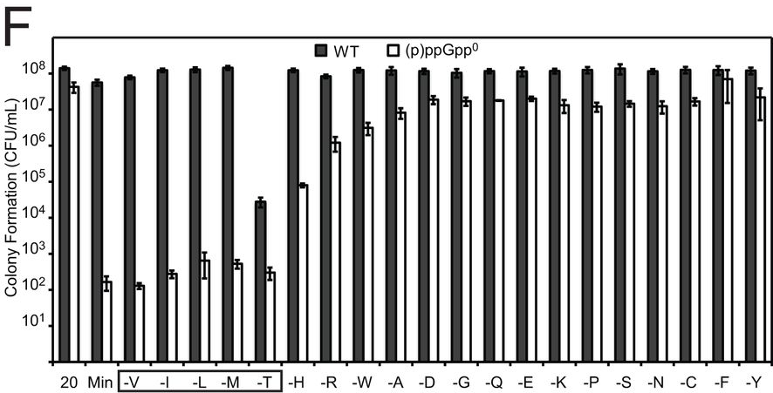
Amino acid auxotrophy in (p)ppGpp⁰ cells
Kriel, A, et al. J Bac, 2014.

Slide 55
Designing amino acid biosynthetic transcriptional reporters
Promoter
firefly luciferase
Selected promoters upstream of amino acid biosynthetic operons
Primarily focused on BCAA, Met, and Ser

Slide 56
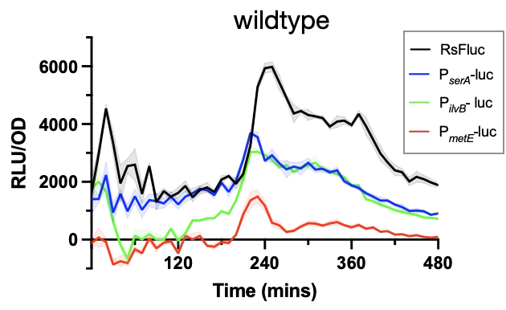
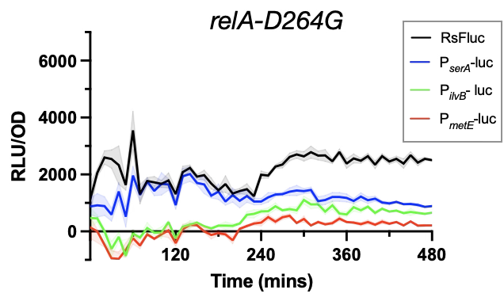
Transcriptional response to increases in (p)ppGpp
Hydorn et al. 2025

Slide 57
Aim 2: Characterize bacterial (p)ppGpp metabolism and (p)ppGpp-dependent physiology
Evaluate (p)ppGpp synthetases relative contributions to metabolism
Evaluate (p)ppGpp hydrolase contribution to metabolism
Determine environmental factors effect on metabolism
Assess transcriptional response to (p)ppGpp
Examine (p)ppGpp-dependent physiology

Slide 58
Physiological response to increases in (p)ppGpp
Hydorn et al. 2025

Slide 59
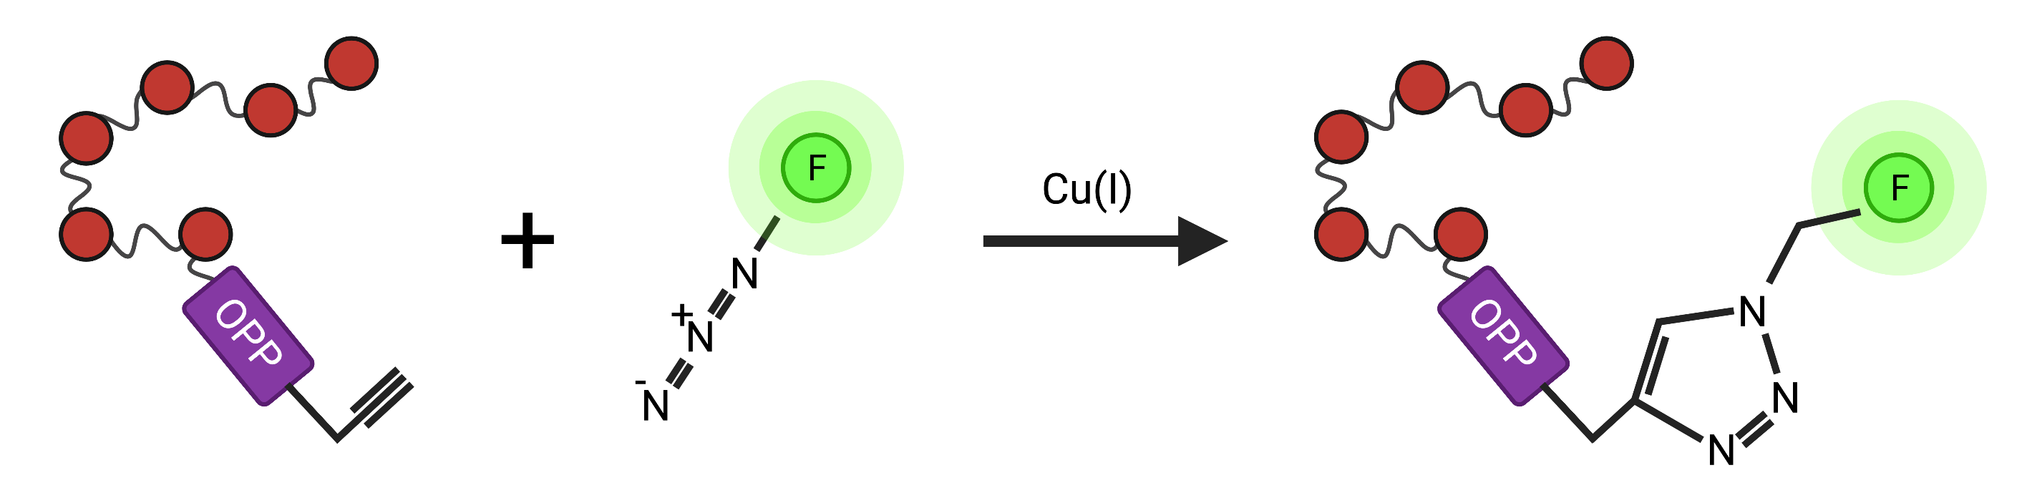
Monitoring in vivo protein synthesis levels using O-propargyl-puromycin (OPP) labeling
OPP
OPP
Peptide containing alkyne modified puromycin (OPP)
Alexa Fluor™ with azide group
Fluorescently labelled cyclization product
Simon Diez

Slide 60
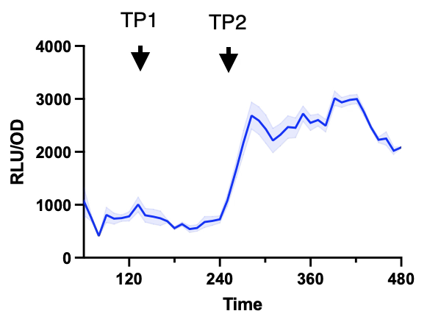
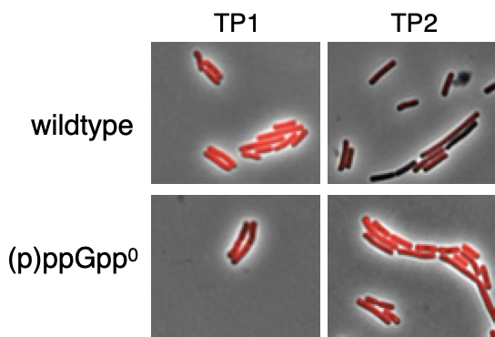
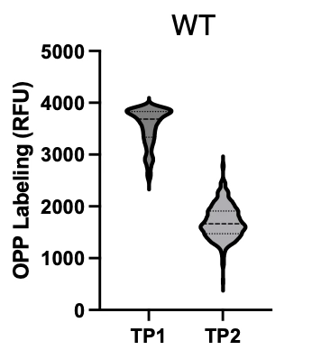
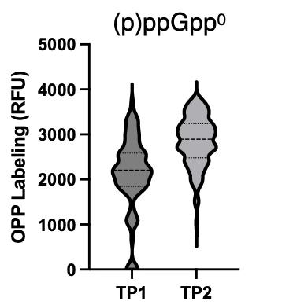
Protein synthesis levels during increases in (p)ppGpp
Hydorn et al. 2025

Slide 61
Aim 2: Characterize bacterial (p)ppGpp metabolism and (p)ppGpp-dependent physiology
Evaluate (p)ppGpp synthetases relative contributions to metabolism
Evaluate (p)ppGpp hydrolase contribution to metabolism
Determine environmental factors effect on metabolism
Assess transcriptional response to (p)ppGpp
Examine (p)ppGpp-dependent physiology

Slide 62
Aims of this thesis
Aim 1: Develop and validate a (p)ppGpp detection tool
Aim 2: Characterize bacterial (p)ppGpp metabolism and (p)ppGpp-dependent physiology
Aim 3: Analyze (p)ppGpp signaling heterogeneity within a population

Slide 63
Aim 3: Analyze (p)ppGpp signaling heterogeneity within a population
Develop and characterize a single cell (p)ppGpp detection tool
Identify factors that contribute to single-cell signal
Assess correlation between heterogeneity in (p)ppGpp and transcriptomes

Slide 64
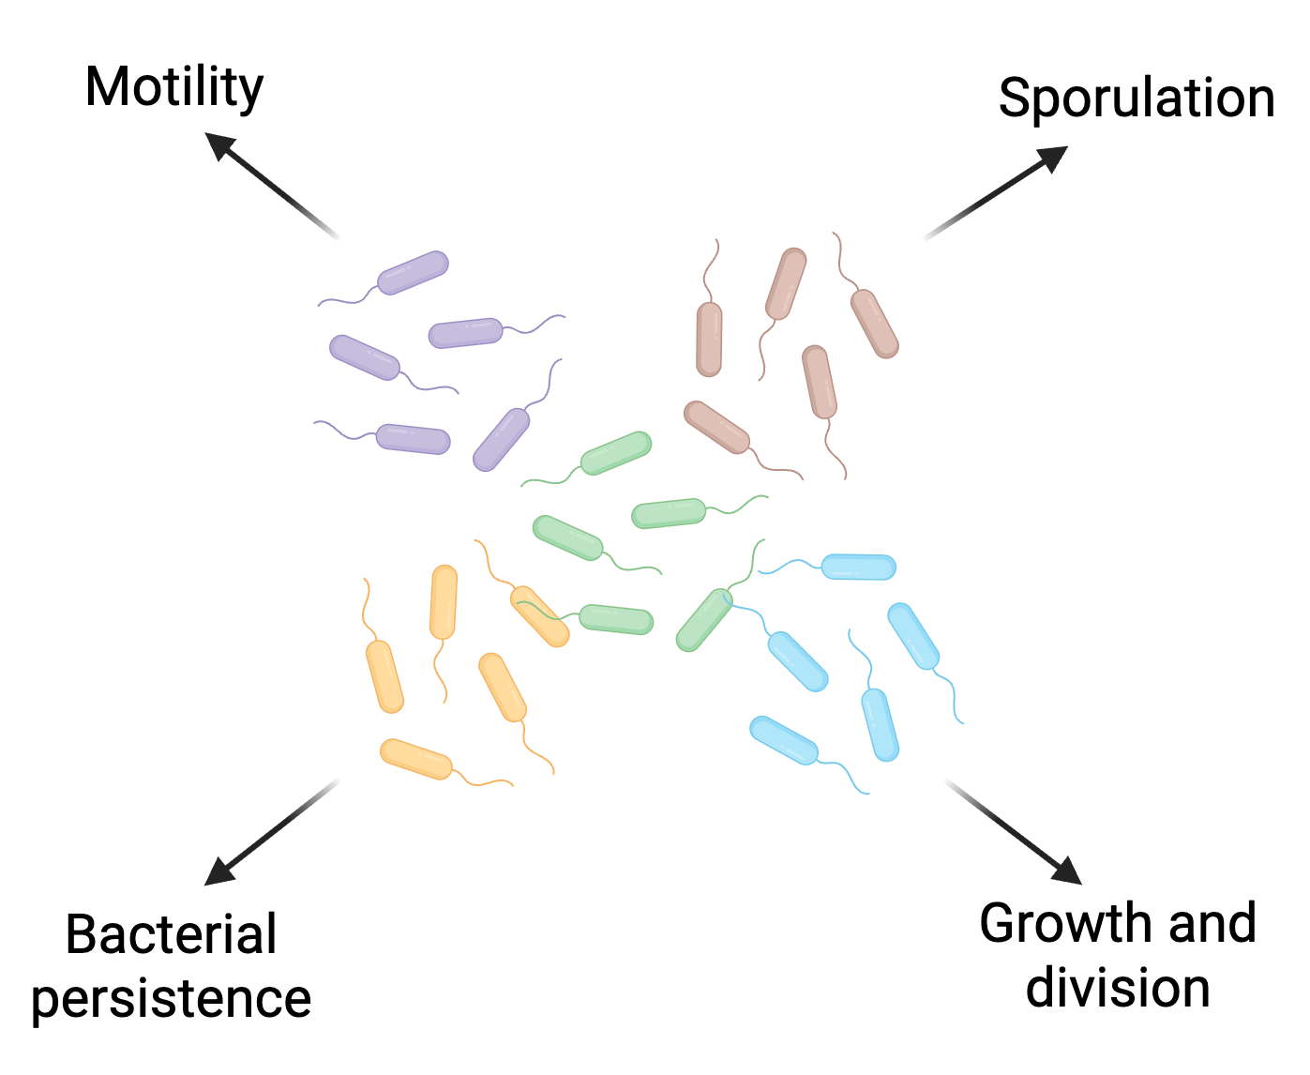
Bacterial heterogeneity as an evolutionary bet-hedging strategy

Slide 65
Dynamic (p)ppGpp luciferase reporter in model bacterium, Bacillus subtilis
ilvE riboswitch
Physpank
RsFluc
firefly luciferase
Specific
Robust at reporting acute changes
Accurate
Population level
Notes:
There are a couple of advantages to using this luminescent reporter. One being unlike a fluorescent reporter, there is no background luminescence, allowing for high signal to noise. Another being that the luciferase protein has 5 minute half life in bacillus, getting degrading quite quickly after being synthesize. This allows for a very dynamic luminescent readout, reporting on changes in ppGpp in a very short time scale. Using this construct integrated at a nonessential locus in the genome, we can monitor changes in ppGpp levels throughout growth as changes in luminescence.

Slide 66
Engineering a single cell reporter in B. subtilis
ilvE riboswitch
Physpank
RsGFP
gfp
Single cell level
Cumulative
Notes:
To look at single cell level, we employed a gfp reporter as luciferase cannot be measured at the single cell level. Following the same formula as we did for luciferase, we fused both the WT and mutant riboswitch upstream of our gfp reporter gene and monitored fluorescence throughout growth.

Slide 67
RsGFP signal throughout growth
120 mins
180 mins
240 mins
300 mins
Time
Notes:
What we saw as the cells grew from exponential to transition phase was that the cells became more fluorescent, indicating that they were reporting on a wave ppGpp production, and we see it does so heterogeneous, shown here with some brighter and dimmer cells within the population. In our mutant riboswitch control, we saw this increase significantly attenuated.

Slide 68
Single-cell (p)ppGpp reporter with mutant riboswitch, RsGFP^{mut}
ilvE riboswitch
Physpank
RsGFP
gfp
ilvE mut riboswitch
Physpank
RsGFP^{mut}
gfp
Notes:
Engineering this ppGpp insensitive riboswitch, we similarly fused it upstream of luciferase and downstream of our inducible promoter and monitored luminescence of this construct throughout growth.

Slide 69
RsGFP and RsGFP^{mut} signal throughout growth
120 mins
180 mins
240 mins
300 mins
RsGFP
RsGFP^{mut}
Notes:
What we saw as the cells grew from exponential to transition phase was that the cells became more fluorescent, indicating that they were reporting on a wave ppGpp production, and we see it does so heterogeneous, shown here with some brighter and dimmer cells within the population. In our mutant riboswitch control, we saw this increase significantly attenuated.

Slide 70
Aim 3: Analyze (p)ppGpp signaling heterogeneity within a population
Develop and characterize a single cell (p)ppGpp detection tool
Identify factors that contribute to single-cell signal
Assess correlation between heterogeneity in (p)ppGpp and transcriptomes

Slide 71
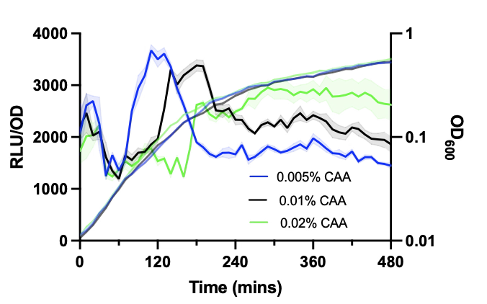
Environmental factors contribute to RsFluc
RsFluc
RsFluc^{mut}
Hydorn et al. 2025

Slide 72
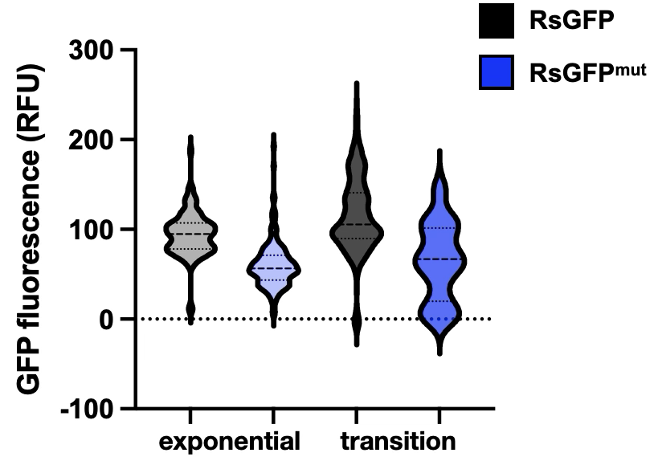
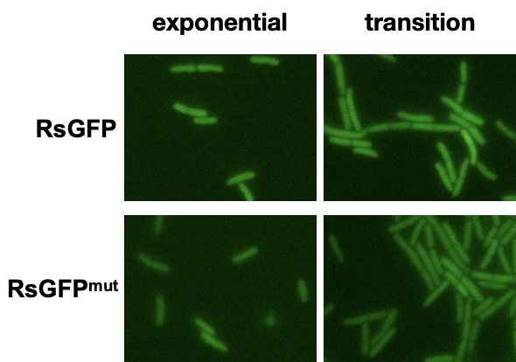
Heterogeneity and signal in amino acid supplementation

Slide 73
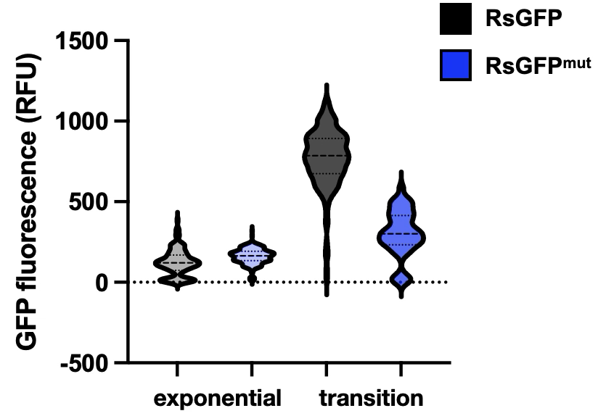
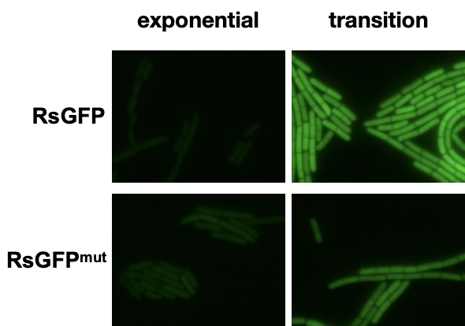
Heterogeneity and signal in prototrophic conditions

Slide 74
Heterogeneity and RsGFP signal in media±amino acid supplementation
No supplementation
+CAA
exponential
transition

Slide 75
Aim 3: Analyze (p)ppGpp signaling heterogeneity within a population
Develop and characterize a single cell (p)ppGpp detection tool
Identify factors that contribute to single-cell signal
Assess correlation between heterogeneity in (p)ppGpp and transcriptomes

Slide 76
Biological relevance of (p)ppGpp
Transcription
Notes:
ppGpp has a number of biological targets, working to downregulate metabolism and growth of cells by slowing key processes. ppGpp has been shown to attenuate DNA replication, slowing a necessary step for division. Work from our own lab by former student Simon with the Gonzalez lab down in chemistry at the morningside campus has demonstrated how ppGpp blocks translation by inhibiting ribosomal initiation complex formation. Additionally, work in the field has shown how ppGpp acts to block transcription, in some organisms like E coli by binding RNAP directly to slow global transcription, but work in our own lab by a postdoc you’ve heard from here at RIP last time, Sathya, has demonstrated how ppGpp works to also upregulate the transcription of certain genes, particularly stationary phase genes. Because ppGpp is such a key player for downregulating the processes and preparing the cells for less favorable conditions, there is a lot of interest in understanding the metabolism of ppGpp itself and the different cellular physiologies of cells with higher or lower ppGpp levels, which is precisely what I hope to address in my project.

Slide 77
Heterogeneity in transcriptomes
(p)ppGpp
(p)ppGpp
(p)ppGpp
(p)ppGpp

Slide 78

Using scRNA-seq probes to assess heterogeneity of transcriptomes
ilvE riboswitch
Physpank
firefly luciferase
Adam Rosenthal, UNC
Notes:
We also wanted to assess how that heterogeneity affected the transcriptomes of these high reporter cells. In collaboration with Adam Rosenthal at UNC, we came up with the idea to design oligos along our luciferase reporter gene and perform scRNA-seq to a culture as it is experiencing a wave of luminescence.

Slide 79
Assess heterogeneity in luciferase transcription during wave of (p)ppGpp

Slide 80
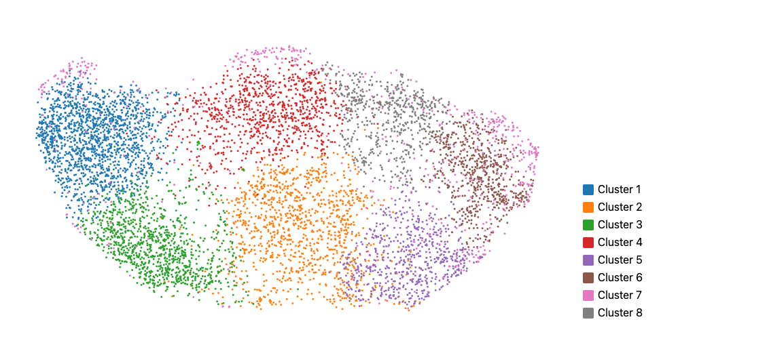
scRNA-seq showed diverse clustering within population during (p)ppGpp wave
High luciferase mRNA cells
Adam Rosenthal, UNC
Notes:
What we saw was very striking as there was actually huge diversity within the populations transcriptomes, displayed here by UMAP clustering each with distinctive defining features. We saw that our high luciferase cells were specifically coming up in the cluster shown here, and in fact this cluster displayed a profile in keeping with a nutritional stress response, showing upregulated biofilm formation genes, antibiotic synthesis genes, ABC transporters which are key players in antibiotic tolerance, sporulation and competence genes. This analysis will give us some inroads to begin investigating how high ppGpp confers increased tolerance to stresses and new genes to investigate for ppGpp dependent expression.

Slide 81
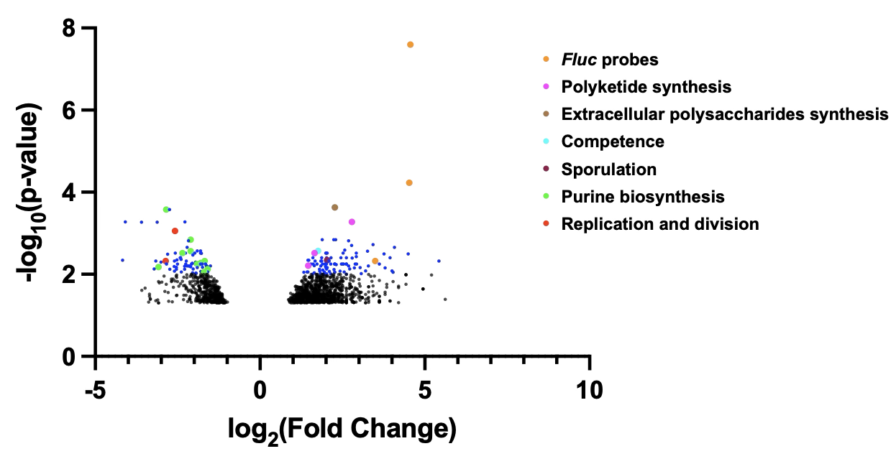
Analysis of transcriptomes in Cluster 4

Slide 82
Aim 3: Analyze (p)ppGpp signaling heterogeneity within a population
Develop and characterize a single cell (p)ppGpp detection tool
Identify factors that contribute to single-cell signal
Assess correlation between heterogeneity in (p)ppGpp and transcriptomes

Slide 83
Aims of this thesis
Aim 1: Develop and validate a (p)ppGpp detection tool
Aim 2: Characterize bacterial (p)ppGpp metabolism and (p)ppGpp-dependent physiology
Aim 3: Analyze (p)ppGpp signaling heterogeneity within a population

Slide 84
Future Directions
Assess relationship between heterogeneity in (p)ppGpp and in bacterial physiology
Sporulation, competence, EPS synthesis highlighted in scRNA-seq
Antibiotic tolerance and protein synthesis as longstanding questions in the field
Examine heterogeneity in amino acid biosynthesis expression and the correlation with heterogeneity in (p)ppGpp
Use tool to assess (p)ppGpp signaling in variety of conditions
In use in E. coli and Caulobacter crescentus
Assess differing media, stressors, small molecules, etc.

Slide 85



Acknowledgments
Jonathan Dworkin
Sathya Nagarajan
Kiera Englehart
Evan Waldron
Gilberto Padron
Simon Diez
Abigail Whalen
Carrie Harwood, UW
Elizabeth Fones
Adam Rosenthal, UNC
Christopher Baumann
Thesis Committee
Lars Dietrich
David Dubnau
Ruben Gonzalez
Anne Moscona
Sam Sternberg
Cellular Physiology and Biophysics and Microbiology and Immunology Departments

Slide 86

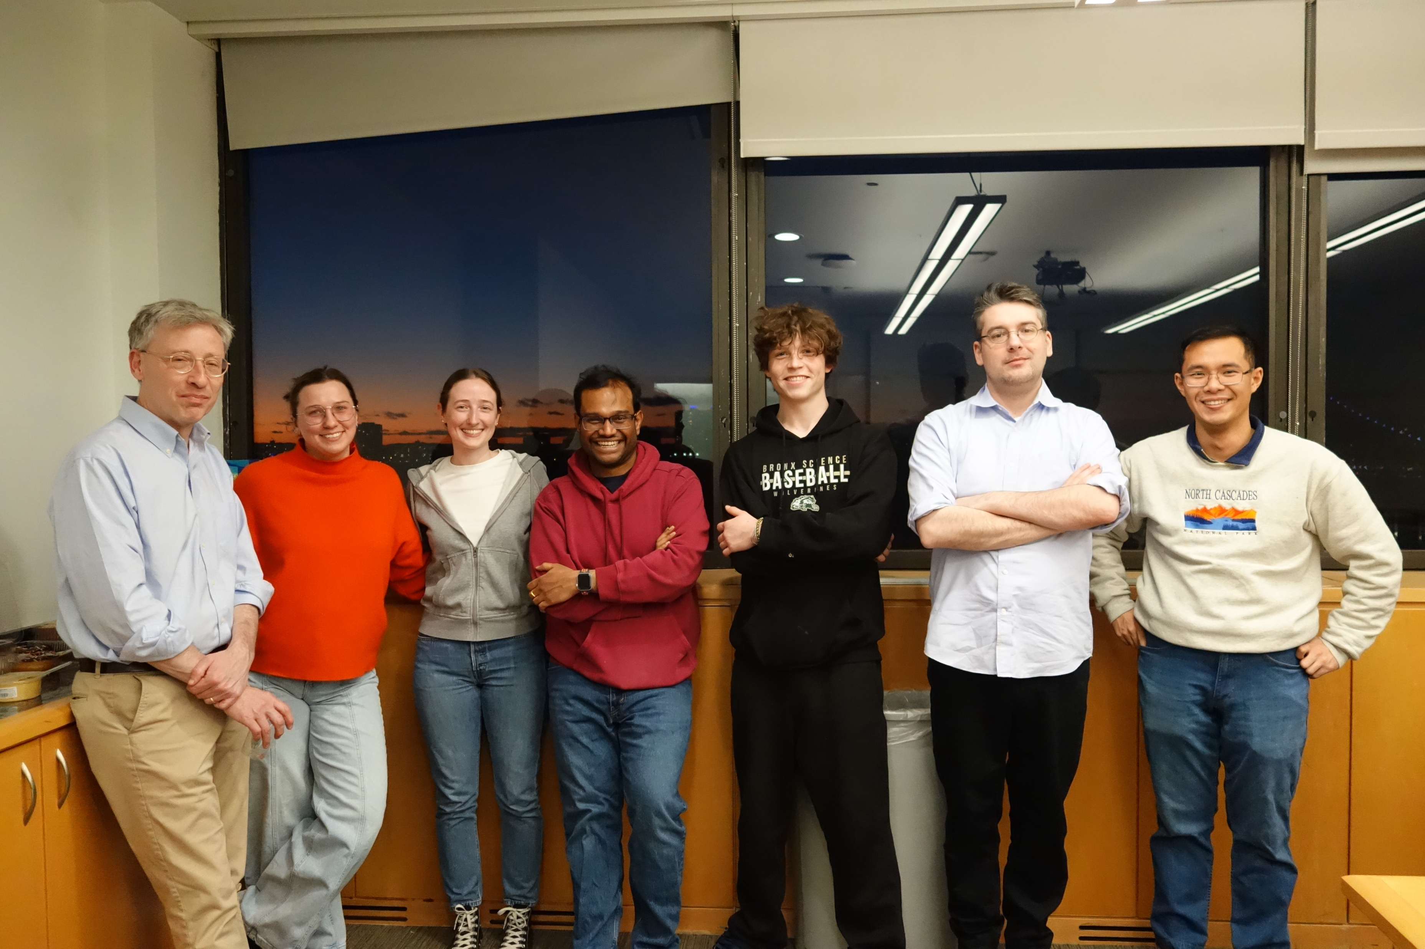



Slide 87

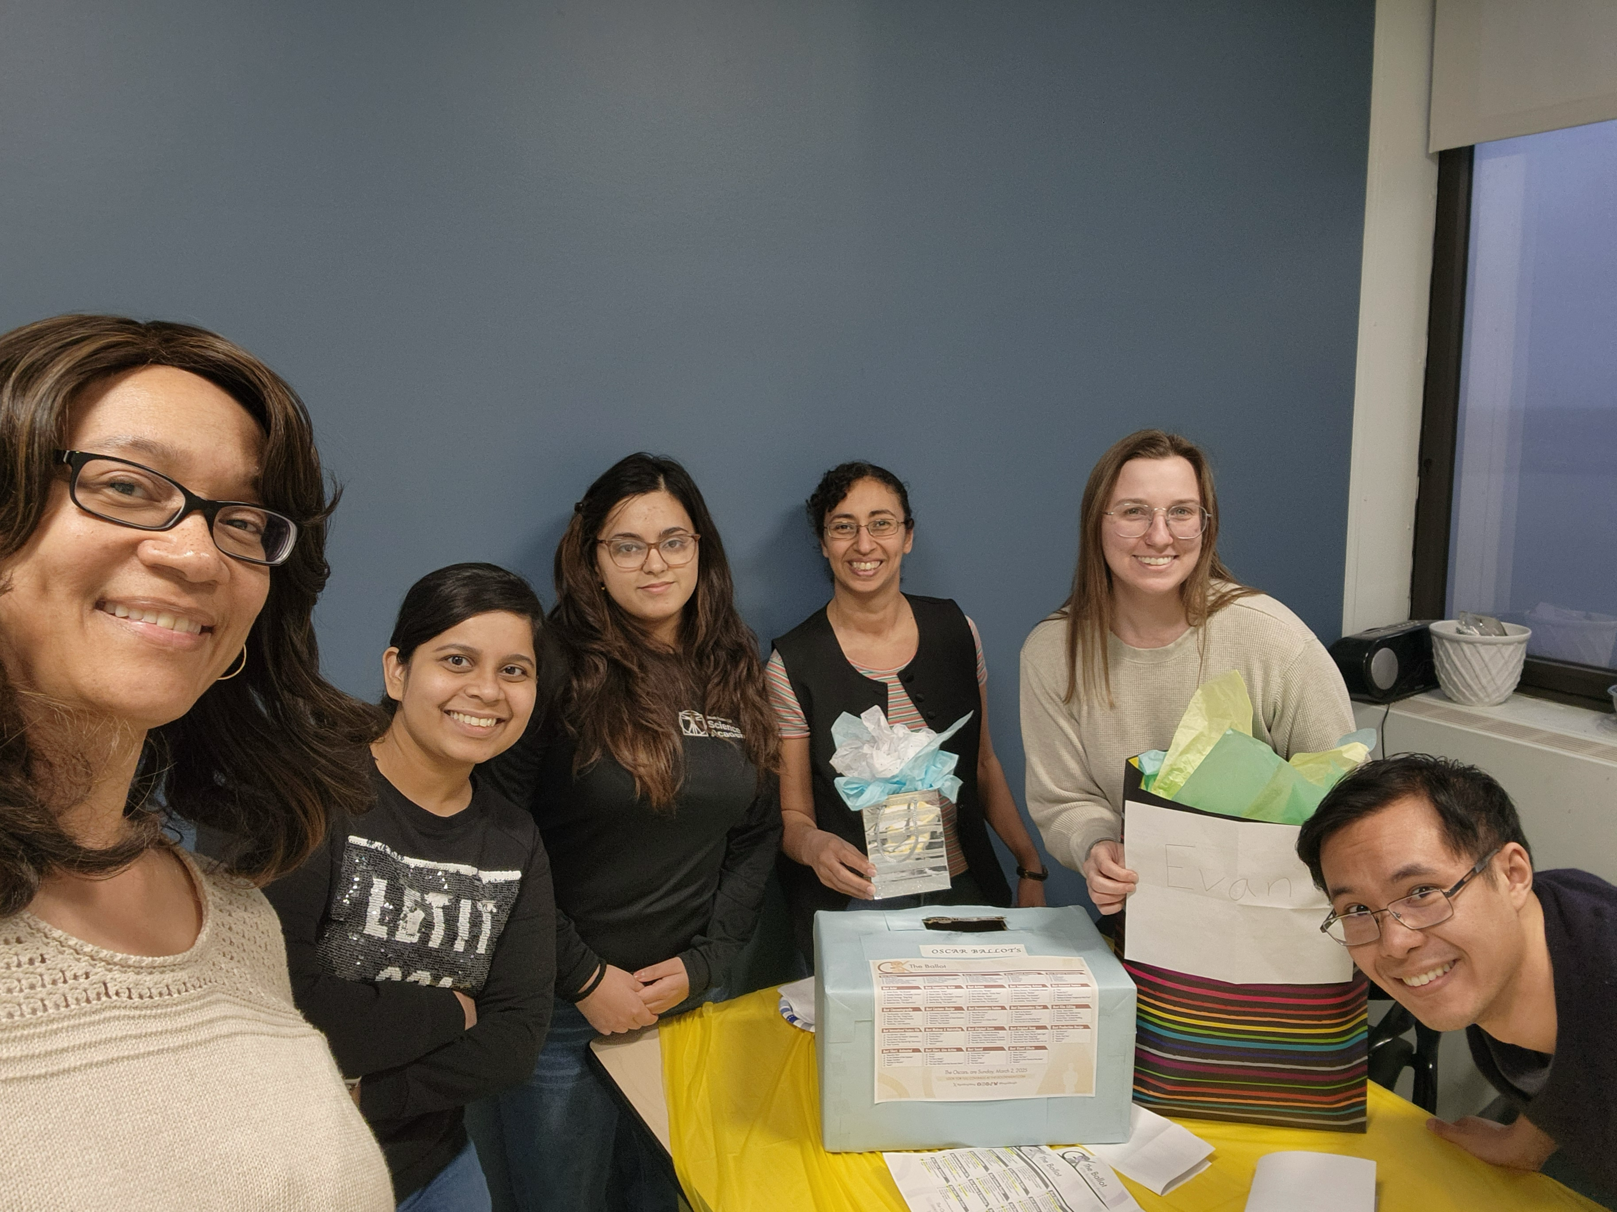
All the 12th floor fun not pictured!

Slide 88


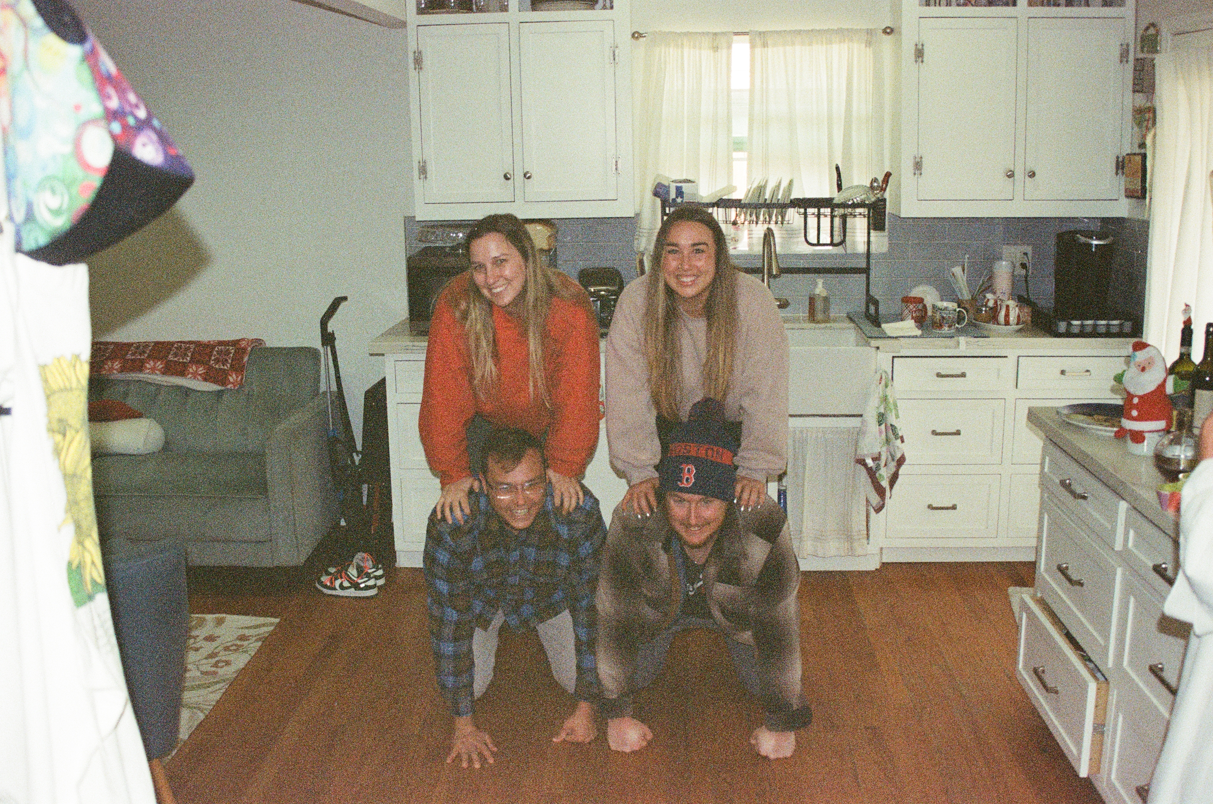
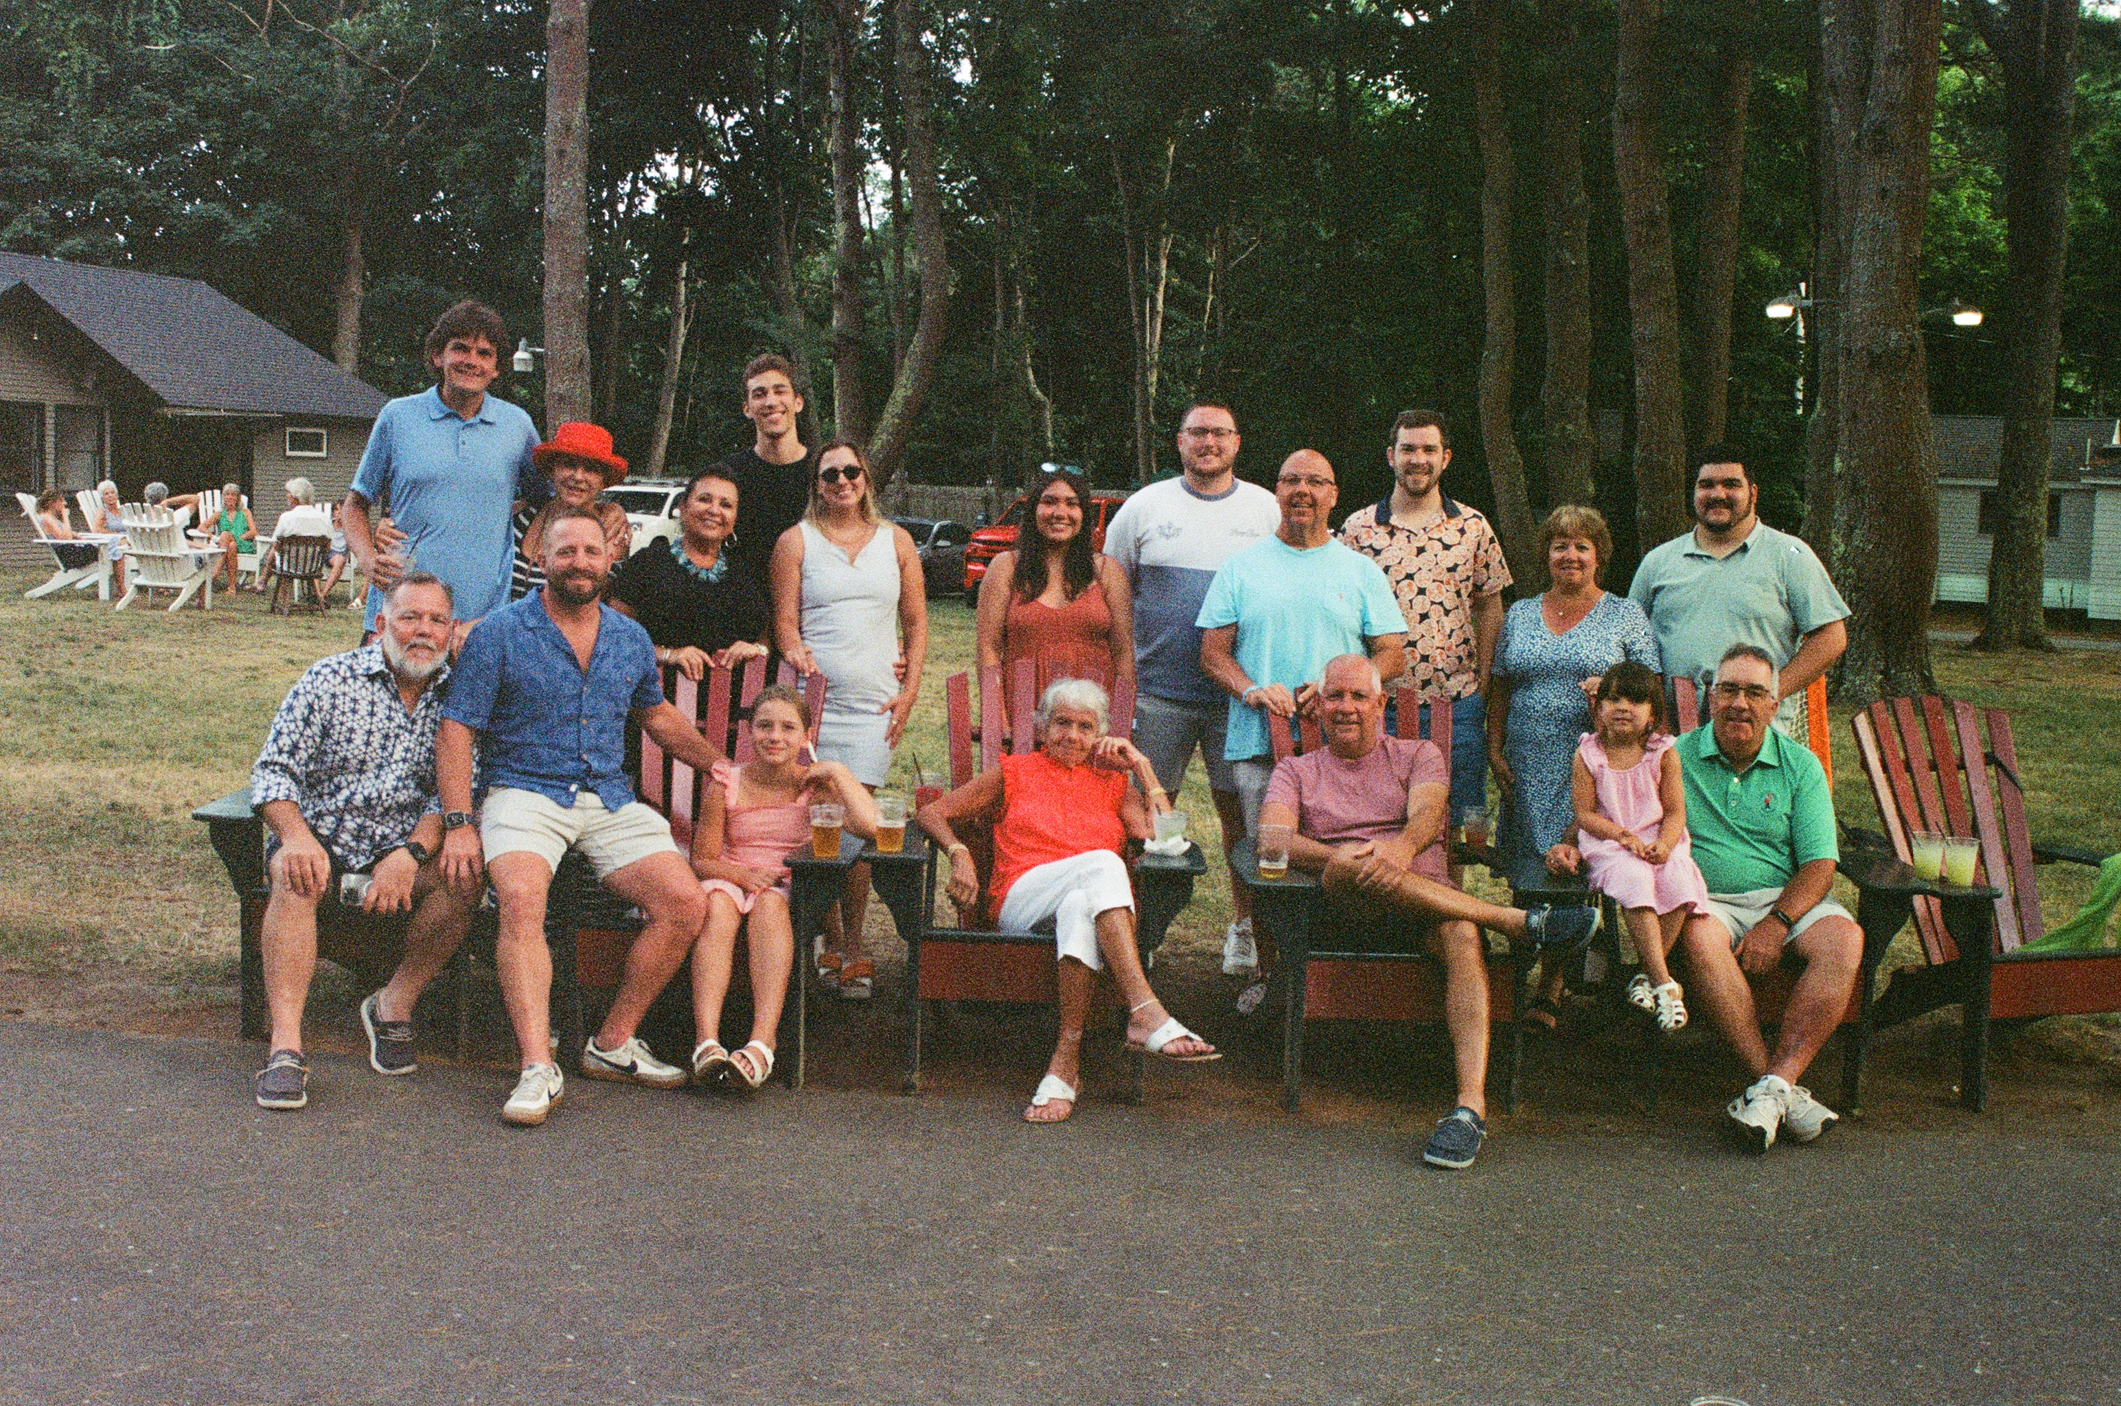


Slide 89




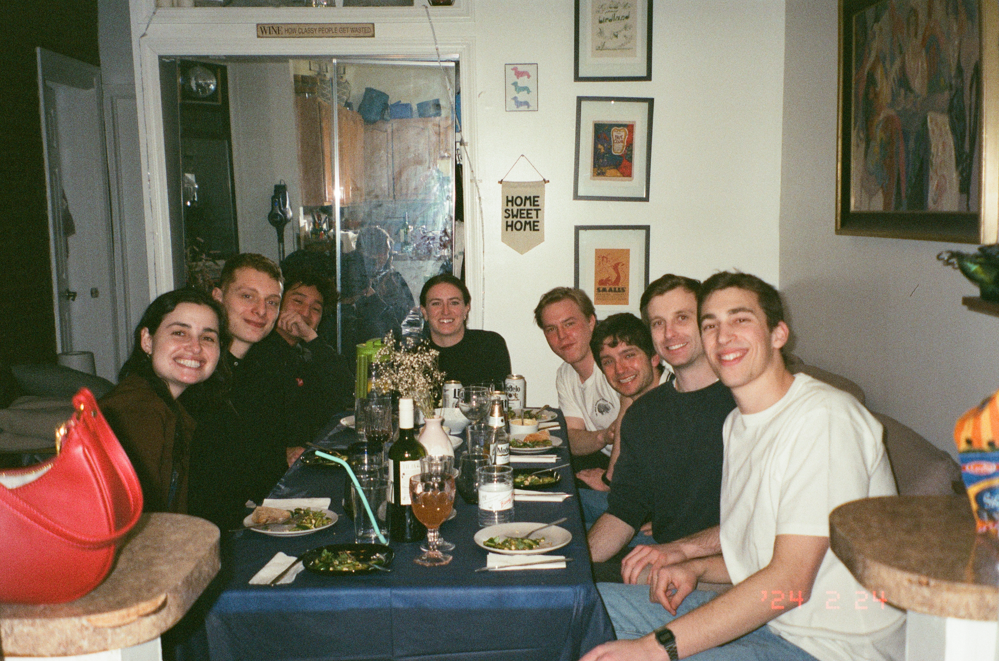



Slide 90
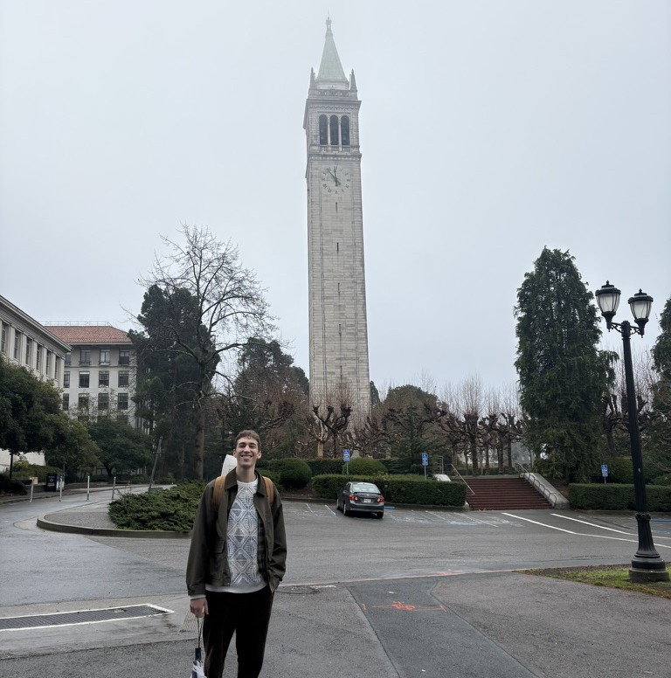




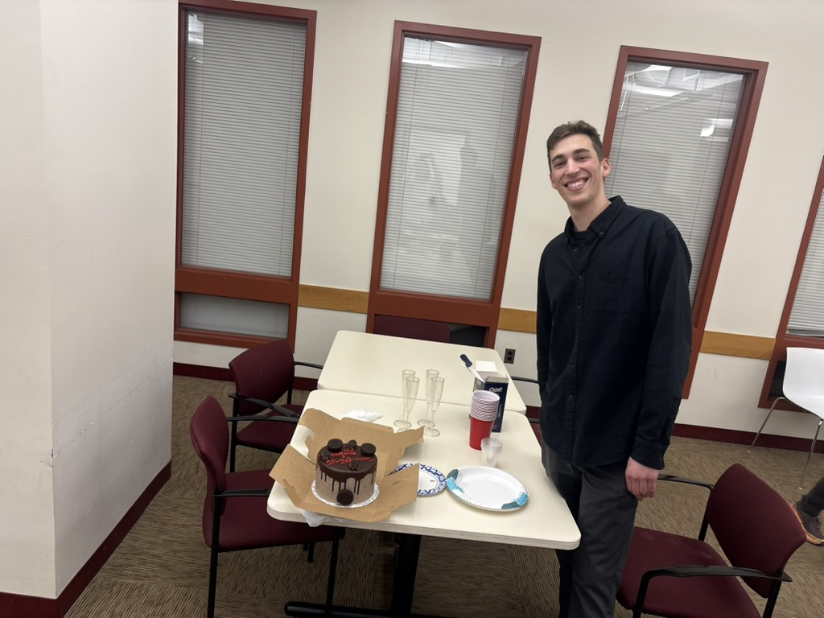
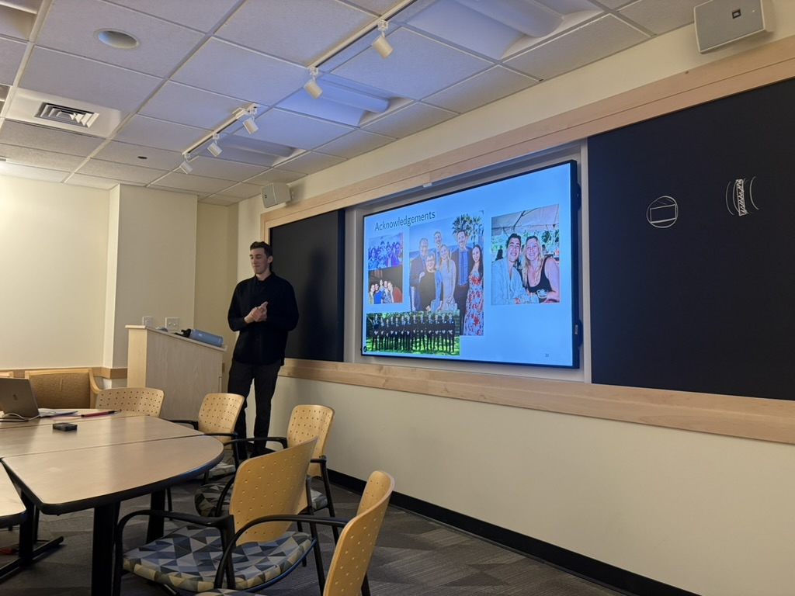

Slide 91
Questions

Slide 92
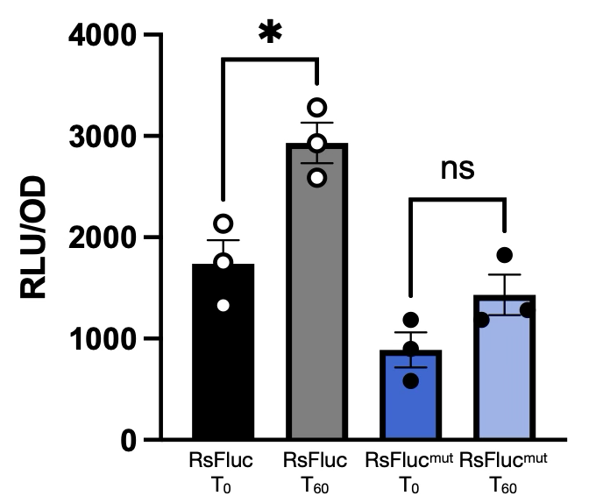
mupirocin

Slide 93
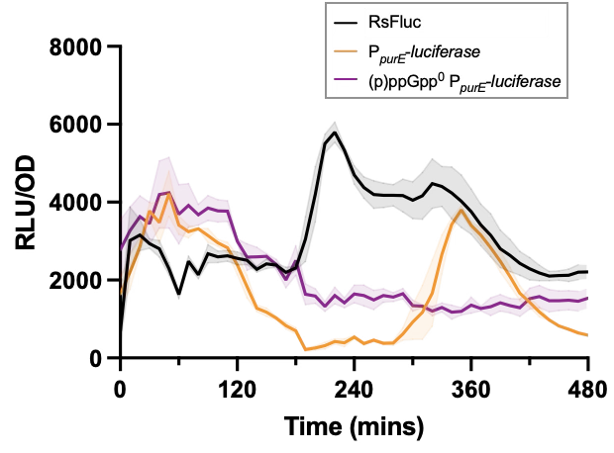
Known (p)ppGpp dependent pathways (purE)
Sathya Nagarajan

Slide 94
Evaluating the contributions of hydrolases to (p)ppGpp metabolism
PliaI
relA
PliaI
relA D78A

Slide 95
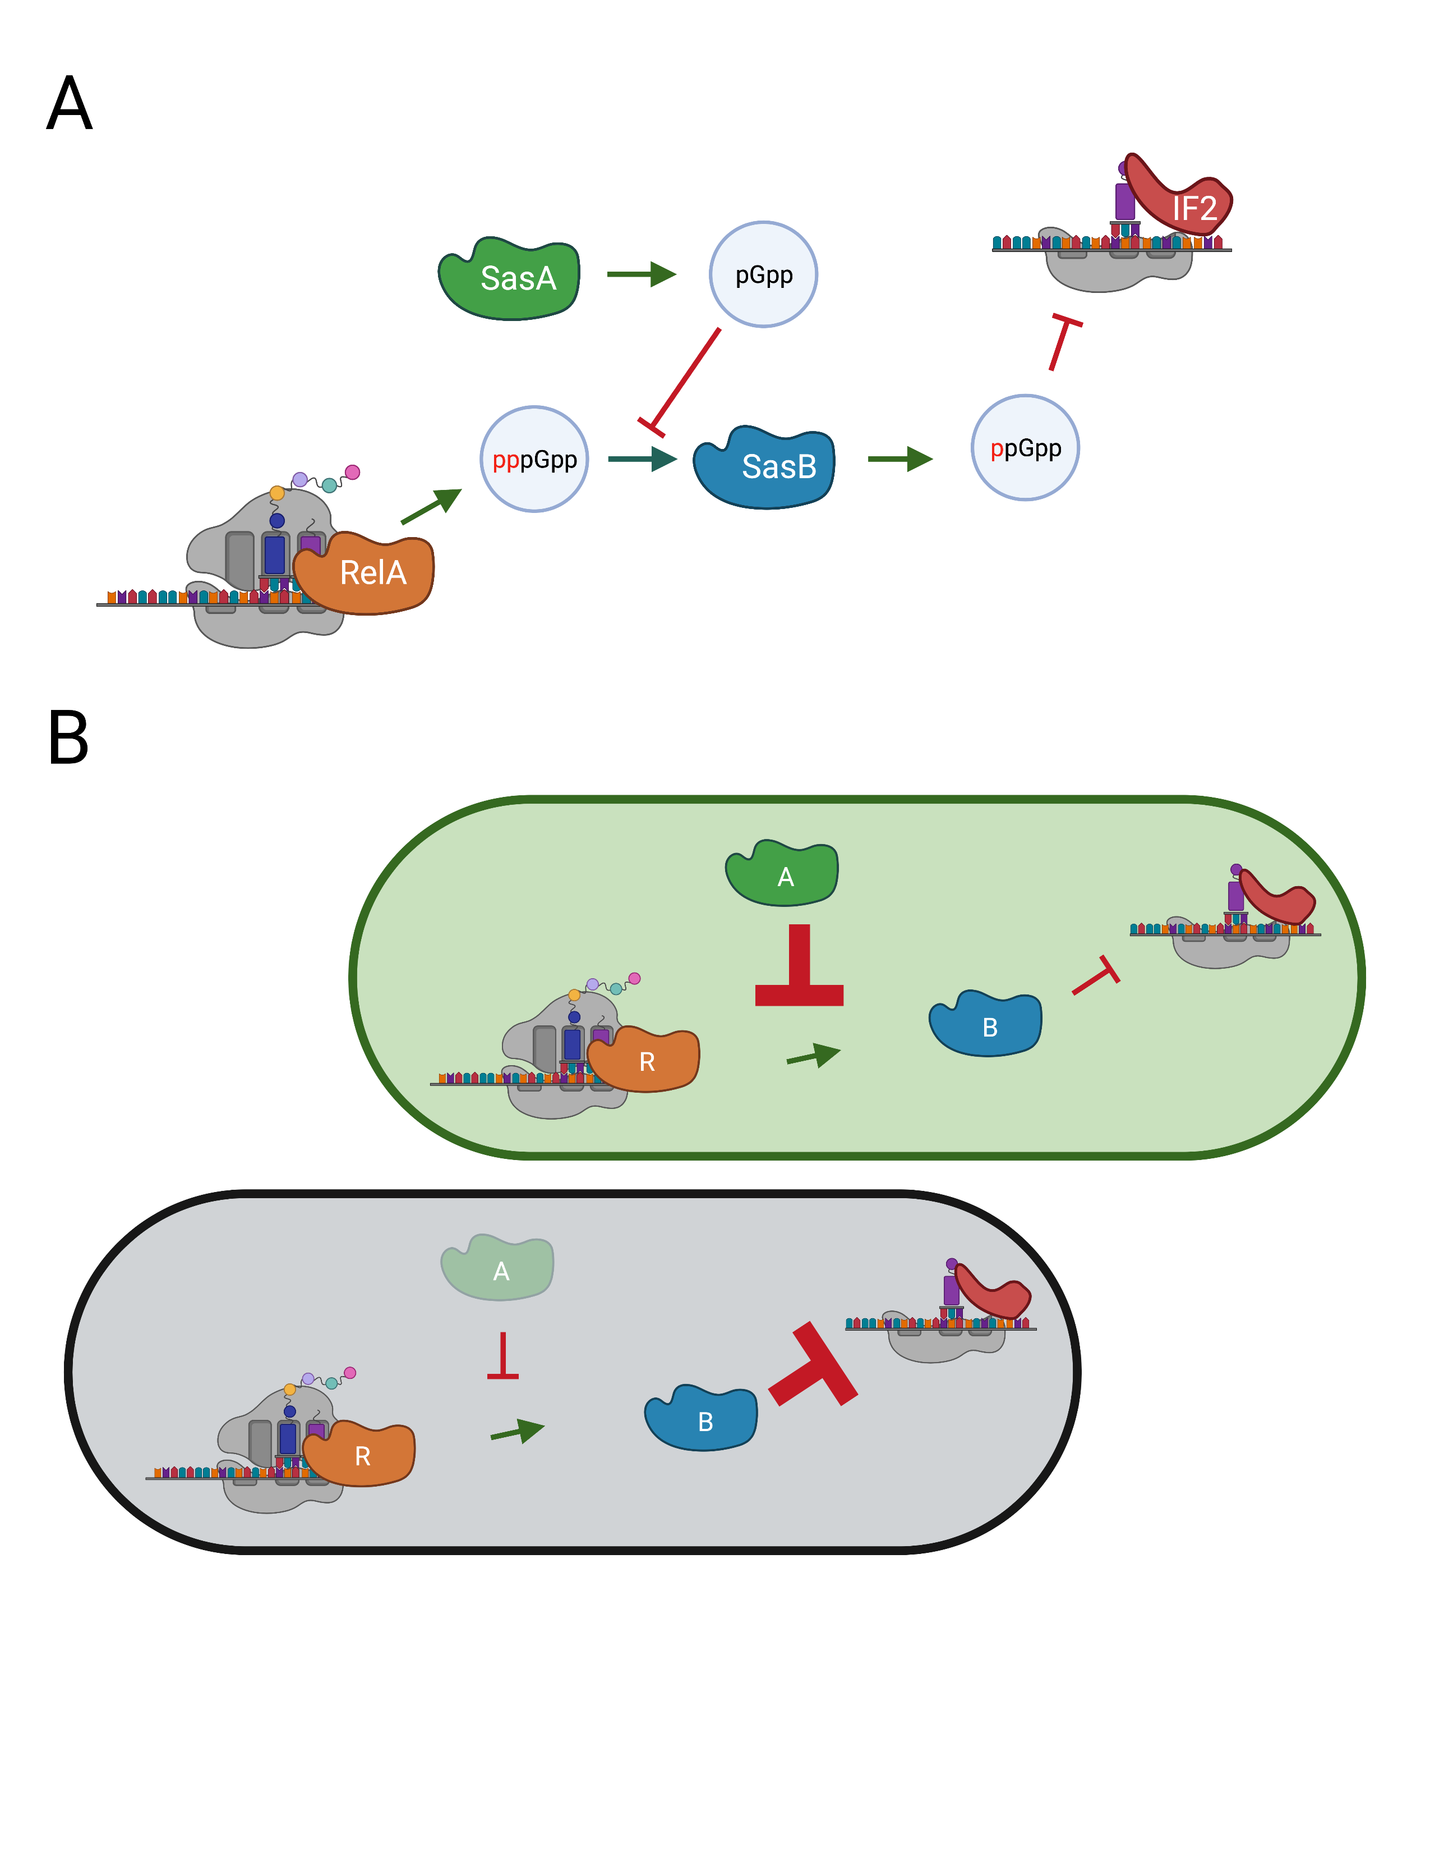
Small Alarmone synthetases in B. subtilis

Slide 96
Small Alarmone synthetases in B. subtilis

Slide 97
Relative contributions of (p)ppGpp synthetases in B. subtilis during acute amino acid starvation

Slide 98
Contributions of allosteric synthetase network

Slide 99
Contributions of allosteric synthetase network

Slide 100
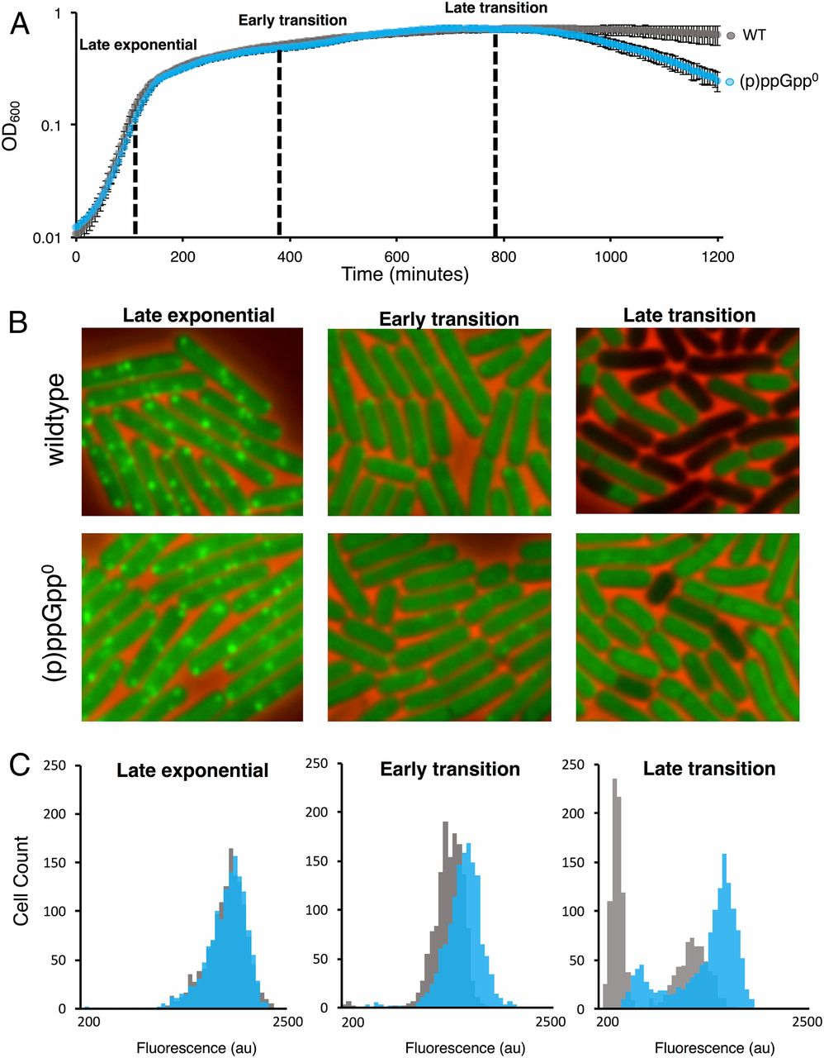
Measuring protein synthesis in B. subtilis via OPP labeling
WT OPP fluorescence
(p)ppGpp⁰ OPP fluorescence
Diez, S, et al. PNAS, 2020.
Notes:
ppGpp do not see diminishing protein synthesis levels to same degree and in fact lose the strong bimodality seen in WT late trans

Slide 101
Biochemical validation of luciferase dynamics
Notes:
The final experiments we wanted to do to validate our reporter is to verify that changes in ppGpp are actually occurring at the points we see differing luminescence in the growth curve. To assess this, in collaboration with Carrie Harwood’s lab at UW, we performed LC-MS analysis, selecting at low luminescence, high luminescence, and low luminescence time points. To do this, I cultured my reporter strain, taking samples for analysis on the luminometer and simultaneously preparing them for LC-MS by concentrating, extracting the nucleotides, and freezing the samples for further steps in Seattle.

Slide 102
RelA catalytic cycle
Created with BioRender.com

Slide 103
Hydrolase activity essential in B. subtilis

Slide 104
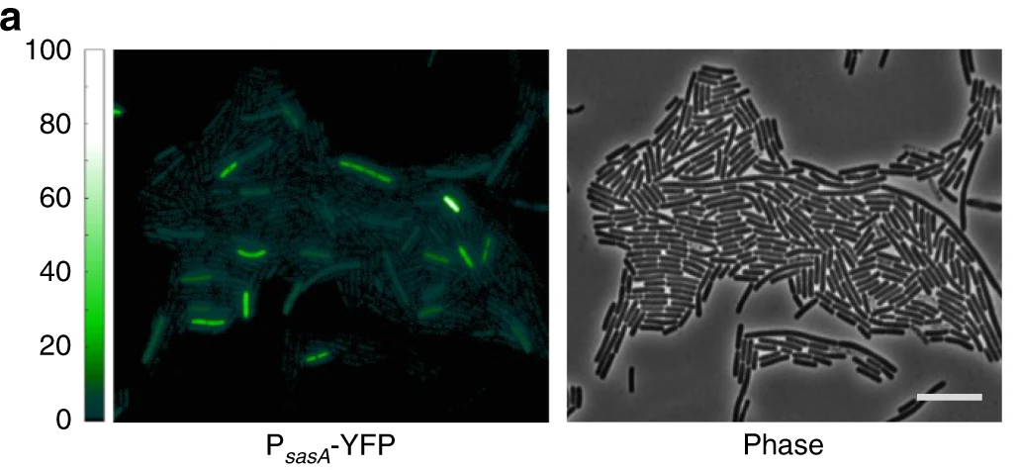
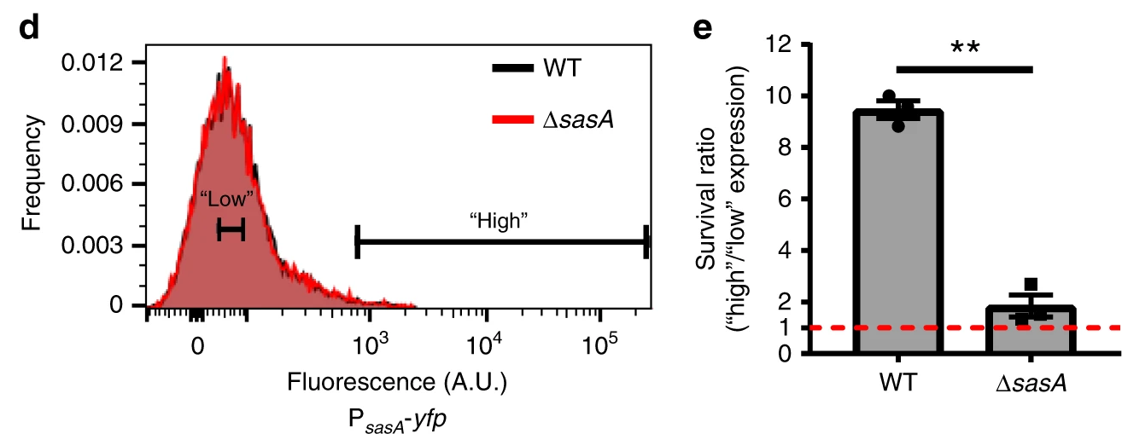
Increased antibiotic tolerance in high nucleotide synthetase cells
PsasA
yfp
Libby, E, et al. Nature Communications, 2019.
Notes:
To address this hypothesis, a former postdoc in the lab, now faculty at Northeastern, developed a fluorescent gene reporter for ppGpp synthetase, sasA. The assumption was that in cases of high ppGpp synthetase, there are likely elevated ppGpp levels. She observed this fluorescent reporter construct under the microscope and what she was rather struck by was the population was rather heterogeneous with a large population with relatively low sasA and a small population of very high sasA, and presumably ppGpp. She used this observation to carry out a FACS analysis, sorting the top fluorescing cells from the population and the lowest fluorescing cells from the population. She then treated the cells with the antibiotic ciprofloxacin and measured survival. What she found was that the high sasA population survived at 10-fold higher rate than the low sasA population. Again however, she was looking at synthetase levels rather than ppGpp levels. To ask this same question looking at ppGpp levels, we developed a single cell riboswitch-based reporter.

Slide 105
Using RNA probes to assess heterogeneity of reporter transcripts
ilvE riboswitch
Physpank
gfp
firefly luciferase
Notes:
Another method we employed to assess heterogeneity in ppGpp levels is the use of RNA probes to gauge difference from cell to cell in expression of our reporter protein behind the riboswitch. So to assess this we used a technique called fluorescence in situ hybridization or FISH microscopy with mRNA probes that bind to our gfp reporter.

Slide 106
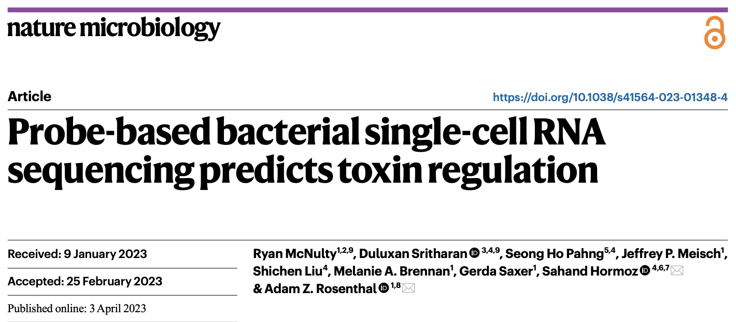


Slide 107





ppGpp contributes to antibiotic tolerance
Notes:
It seems like a lot of people in the field of ppGpp and antibiotic tolerance have been trying to sus out this connection and you can see just from the articles listed here that there is some dependency of ppGpp synthesis and antibiotic tolerance, but up until now, it has been difficult to assess this relationship at the single cell level.

Slide 108








ppGpp mediates pathogenesis and commensal survival in host
Notes:
Not only is ppGpp important for antibiotic tolerance, but also important for pathogenesis in a wide array of pathogenic bacterial species. Its also been shown that ppGpp is important for maintaining commensals in the gut. This has led researchers to want to develop a small molecule inhibitor against ppGpp synthesis as an antivirulence factor

Slide 109


Identifying ppGpp synthetase inhibitors in high throughput screen
2-APB
Frederico Guieros, University of São Paulo
National Center for Biotechnology Information (2024). PubChem Compound Summary for CID 1598, 2-Aminoethyl diphenylborinate.
Notes:
This is precisely what our collaborator Freddy at university of sao paulo brazil set out to do. Using a wide array of commercially available small molecule, he performed a high throughput screen to identify small molecule inhibitors of a ppGpp synthetase in vitro. From this screen he identify a compound known as 2 APB and we wanted to verify this inhibition in culture.

Slide 110
Screening ppGpp synthetase inhibitors in vivo using luciferase reporter
WT
ppGpp⁰
Notes:
Firstly we cultured our luminescent reporter strain in chemically defined medium and monitored the ppGpp production against the controls, our ppGpp null and the mut riboswitch. We then cultured our WT reporter with 2 APB and monitored the luminescent output.

Slide 111
Screening ppGpp synthetase inhibitors in vivo using luciferase reporter
WT
ppGpp⁰
2APB
Notes:
And what we saw was an attenuation of the luminescent signal, indicating inhibition of ppGpp synthetase. While this is not a perfect compound, it is a starting place for developing an antivirulence component, but more importantly to us, it demonstrated the utility of our reporter as a tool for screening for potential therapeutics to treat infections. So with that,

Slide 112

RsFluc response in Gram-negative model organism, E. coli
Varik et al. Scientific Reports 2017

Slide 113
GFP signal throughout growth
120 mins
180 mins
240 mins
300 mins
WT
mut
Notes:
What we saw as the cells grew from exponential to transition phase was that the cells became more fluorescent, indicating that they were reporting on a wave ppGpp production, and we see it does so heterogeneous, shown here with some brighter and dimmer cells within the population. In our mutant riboswitch control, we saw this increase significantly attenuated.

Slide 114
ppGpp-riboswitch reporter fluorescence throughout growth
WT
mut
Time (mins)
Time (mins)
Notes:
When we look at the quantifications of those fluorescent images of our WT reporter, we can visualize the distribution of population and see there is great spread from the lowest fluorescing population and highest, indicating there may be great variation in ppGpp levels. When we look at the quantifications of the mutant again we see attenuated signal. This leads us to asking that same question that Elizabeth did with the synthetase reporter. Do the highest and lowest fluorescing population have different survival after antibiotic exposure? How does it compare to a random sampling of the population? I was able to carry out this FACS experiment only once and still need to iron out some of the conditions, but it looks as if the results are promising.

Slide 115
Biological relevance of (p)ppGpp
Replication
Translation
Transcription
Notes:
I’ll bring you back to the biological relevance of ppGpp. You can see here that ppGpp targets key biological processes necessary for culture growth and division. What you may also note is that these same processes are key targets for development of antimicrobials. It begs the question that if cells are high in ppGpp are they less susceptible to antibiotic exposure?

Slide 116

FACS and regrowth

Slide 117

(p)ppGpp contributes to antibiotic sensitivity
Hypothesis: single cell variation in (p)ppGpp results in variation in antibiotic sensitivity
Notes:
The common hypothesis is that in fact single cell variation in ppGpp levels leads to a subpopulation that is more tolerant to antibiotic, leading to a chronic infection of high ppGpp cells after antibiotic exposure. In fact, previous work in our own lab by former postdoc, now professor at Northeastern, Elizabeth Libby, set out to tackle this question indirectly using a transcriptional reporter of a ppGpp synthetase.

Slide 118
FACS and antibiotic tolerance

